Slide 1
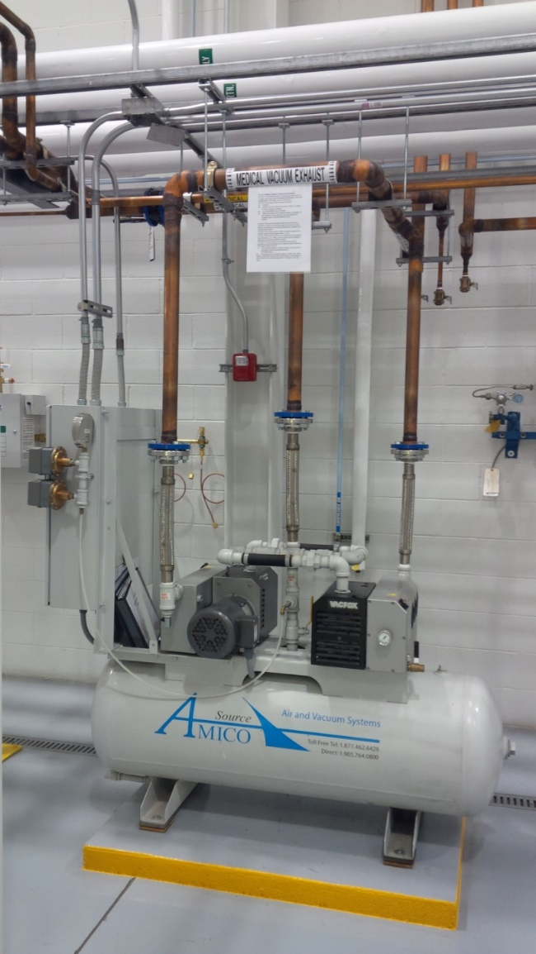
2021 Code
Medical-Surgical Vacuum Systems

Slide 2
5.1.3.7.1 Medical–Surgical Vacuum Central Sources.
Medical–surgical vacuum central supply systems shall be located per 5.1.3.3 as follows:
(1) Indoors in a dedicated mechanical equipment area, adequately ventilated and with any required utilities
5.1.3.7.1.1 Medical–surgical vacuum central supply systems shall consist of the following:
(1) Two or more vacuum pumps sufficient to serve the peak calculated demand with the largest single vacuum pump out of service
(2) Automatic means to prevent backflow from any on-cycle vacuum pumps through any off-cycle vacuum pumps

Slide 3
(5) Piping between the vacuum pump(s), discharge(s), receiver(s), and vacuum source shutoff valve in accordance with 5.1.10.2, except brass, galvanized, or black steel pipe, which is permitted to be used as recommended by the manufacturer
5.1.3.7.2 Vacuum Pumps.
5.1.3.7.2.3 Flexible connectors shall connect the vacuum pumps with their intake and outlet piping.
5.1.3.7.2.4 For liquid ring vacuum pumps, seal water shall be of a quality recommended by the vacuum pump manufacturer.
5.1.3.7.3 Vacuum Receivers.
(1) They shall be made of materials deemed suitable by the manufacturer.

Slide 4
(3) They shall be capable of withstanding a gauge pressure of 415 kPa (60 psi) and 760 mm (30 in.) gauge HgV.
5.1.3.7.4 Vacuum Filtration. Central supply systems for vacuum shall be provided with inlet filtration with the following characteristics:
(1) Filtration shall be at least duplex to allow one filter to be exchanged without impairing vacuum system
(2) Filtration shall be located on the patient side of the vacuum producer.
(3) Filters shall be efficient to 0.3 μ and 99.97 percent HEPA or better, per DOE-STD-3020. Specification for HEPA Filters Used by DOE Contractors.
(4) Filtration shall be sized for 100 percent of the peak calculated demand while one filter or filter bundle is isolated.
(5) It shall be permitted to group multiple filters into bundles to achieve the required capacities.

Slide 5
(6) The system shall be provided with isolation valves on the source side of each filter or filter bundle and isolation valves on the patient side of each filter or filter bundle, permitting the filters to be isolated without shutting off flow to the central supply system.
(7) A means shall be available to allow the user to observe any accumulations of liquids.
(8) A vacuum relief petcock shall be provided to allow vacuum to be relieved in the filter canister during filter replacement.
(9) Filter elements and canisters shall be permitted to be constructed of materials as deemed suitable by the manufacturer.

Slide 6
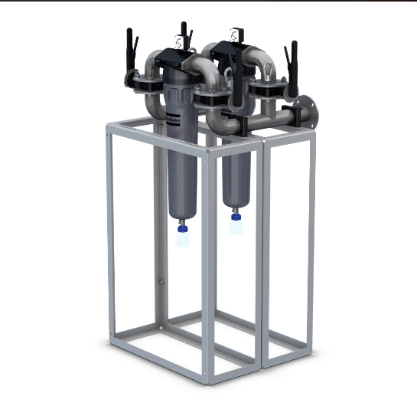
Vacuum Hepa filters

Slide 7
Vacuum Hepa filters

Slide 8
(10) In normal operation, one filter or filter bundle shall be isolated from the system to be available for service should a blockage in the operating filter occur or rotation of the filters be desired after filter element
Exchange.
5.1.3.7.5 Piping Arrangement and Redundancies.
(3) Where only one set of vacuum pumps is available for a combined medical–surgical vacuum system and an analysis, a research, or a teaching laboratory vacuum system, such laboratories shall be connected separately from the medical–surgical system directly to the receiver tank through its own isolation valve and fluid trap located at the receiver, and between the isolation valve and fluid trap, a scrubber shall be permitted to be installed.

Slide 9
5.1.3.7.5.2 The medical–surgical vacuum receiver(s) shall be serviceable without shutting down the medical–surgical vacuum system by any method to ensure continuation of service to the facility’s medical–surgical pipeline distribution system.
5.1.3.7.6 Electrical Power and Control.
(A) Medical vacuum source systems shall be controlled to ensure continuous supply of suction at pressures consistent with Table 5.1.11 under all conditions of system use as follows:
(1) Automatic activation of pump(s) as necessary to supply the demand.
(2) Managing the operation to equalize wear on all pumps. Where this equalization is achieved manually, the facility staff shall arrange a schedule for manual alternation.

Slide 10
(B) Controls shall provide the following functions:
(3) An automatic restart function shall be included, such that the supply of medical vacuum will resume normally after power interruption without manual intervention.
5.1.3.7.7 Medical–Surgical Vacuum Exhaust.
5.1.3.7.7.2 The exhaust shall be located as follows:
(1) Outdoors
(2) At least 7.5 m (25 ft) from any door, window, air intake, or other openings in buildings or places of public assembly
5.1.3.7.7.3 The end of the exhaust shall be turned down and screened or otherwise be protected against the entry of vermin, debris, or precipitation by screening fabricated or composed of a noncorroding material.

Slide 11
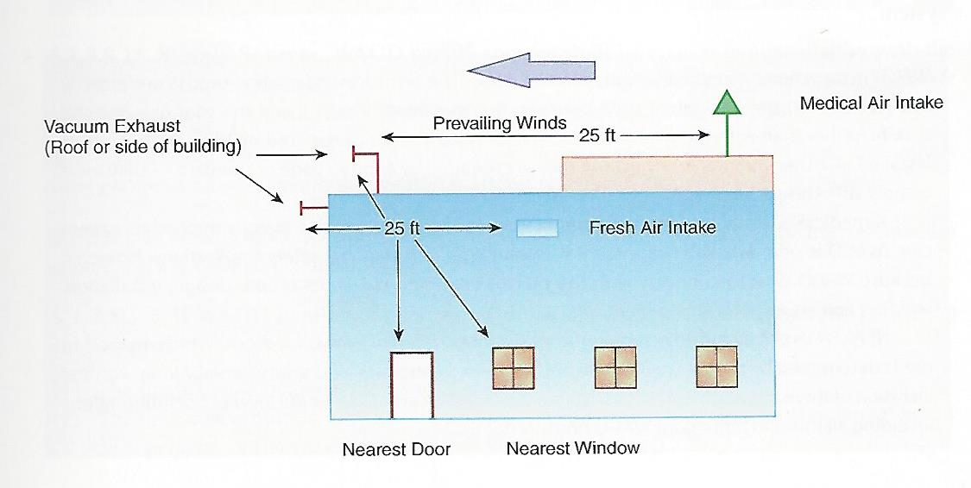

Slide 12
5.1.3.7.7.4 Vacuum exhaust shall be labeled in accordance with 5.1.11.1 with any method that would distinguish it as a vacuum exhaust.
5.1.3.7.7.5 The exhaust shall be free of dips and loops that might trap condensate or oil or provided with a drip leg and valved drain at the bottom of the low point.

Slide 13
5.1.3.7.7.6 Vacuum exhausts from multiple pumps shall be permitted to be joined together to one common exhaust where the following conditions are met:
(1) The common exhaust is sized to minimize back pressure in accordance with the pump manufacturer’s recommendations.
(2) Each pump can be isolated by manual or check valve, blind flange, or tube cap to prevent open exhaust piping when the pump(s) is removed for service from consequent flow of exhaust air into the room.
5.1.3.7.8 Operating Alarms. When the capacity of the medical vacuum supply system not in use is less than the equivalent capacity of one pump, a local alarm shall activate [see 5.1.9.5.4(4)]. This signal shall require manual reset.

Slide 14
Vacuum Sensor Locations

Slide 15
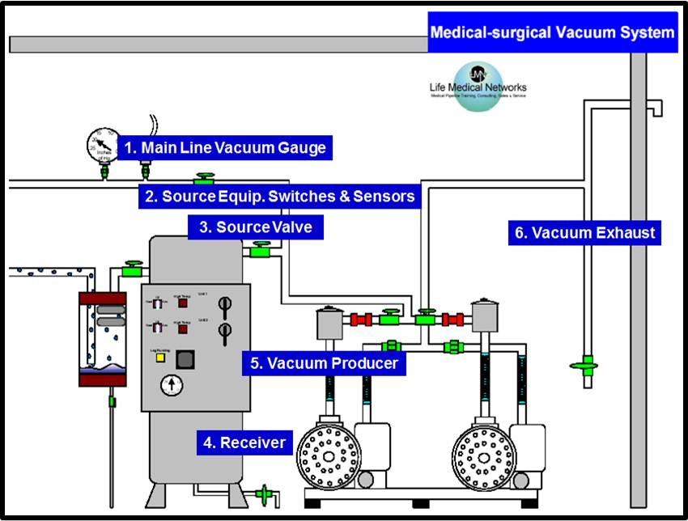
5.1.3.6.1 Source Vacuum Pumps

Slide 16
Contact less Claw Vacuum

Slide 17
5.1.3.8* Waste Anesthetic Gas Disposal (WAGD) Central Supply Systems.
5.1.3.8.1* Supply Sources. WAGD supply sources shall be chosen in consultation with the medical staff having knowledge of the requirements to determine the type of system, number and placement of terminals, and other required safety and operating devices.
5.1.3.8.1.1 WAGD shall be permitted to be produced through the medical–surgical vacuum source, by a dedicated producer, or by venturi.
5.1.3.8.1.2 If WAGD is produced by the medical–surgical vacuum source, the following shall apply:

Slide 18
(2) The total concentration of oxidizers (oxygen) shall be maintained below 23.6 percent, or the vacuum pump shall comply with 5.1.3.8.2.1.
5.1.3.8.1.4 If WAGD is produced by a dedicated WAGD producer with a total power less than 1 horsepower in total (both producers), the following shall apply:
(1) The WAGD source shall be permitted to be located near the inlet(s) served.
5.1.3.8.1.5 For liquid ring pumps in WAGD service, seal water shall be of a quality as recommended by the pump manufacturer.
5.1.3.8.1.6 The WAGD source shall consist of the following:
(1) Two or more WAGD producers sufficient to serve the peak calculated demand with the largest single WAGD producer out of service

Slide 19
5.1.3.8.1.7 If WAGD is produced by a venturi, the following shall apply:
(1) The venturi shall not be user-adjustable (i.e., require the use of special tools).
(2) The venturi shall be driven using water, inert gas, instrument air, or other dedicated air source.
(3) Medical air shall not be used to power the venturi.
5.1.3.8.2 WAGD Producers.
5.1.3.8.2.1 Vacuum pumps dedicated for WAGD service shall be as follows:
(2) Designed of materials and using lubricants and sealants that are inert in the presence of oxygen, nitrous oxide, and halogenated anesthetics
5.1.3.8.2.2 Vacuum producers (e.g., fans or blowers) designed for operation at vacuums below 130 mm (5 in.) HgV shall be as follows:

Slide 20
(4) Used only for WAGD service and not employed for other services
(5) Interconnected via piping, ductwork, and so forth, made of materials determined by the manufacturer as suitable to the service
5.1.3.8.3.2 Where WAGD source systems have two or more producers, and the capacity of the WAGD system not in use is less than the equivalent capacity of one producer, a local alarm shall activate [see 5.1.9.5.4(5)]. This signal shall require manual
Reset
5.1.3.8.4.1
WAGD source systems shall be controlled to ensure continuous flow under all conditions of system use as follows:
(1) Automatic activation of producer(s) as necessary to supply the demand.

Slide 21
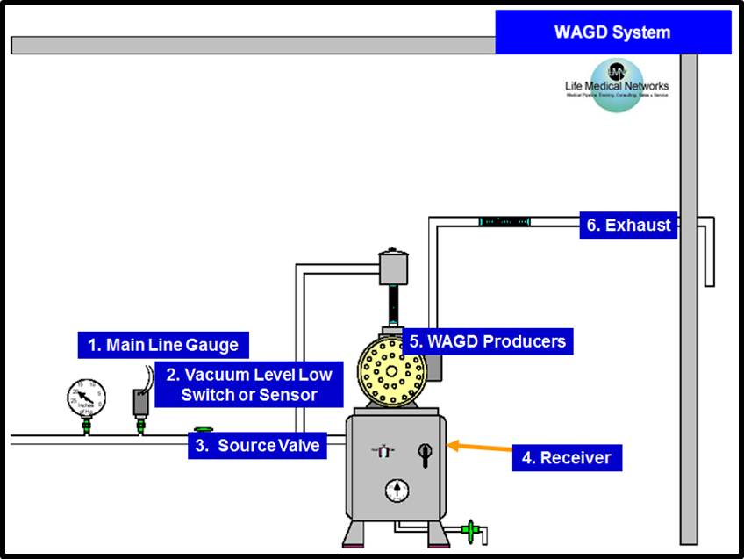
5.1.3.8 WAGD Sources Category1

Slide 22
WAGD Producer

Slide 23
(D) WAGD source system controls shall be provided with electrical systems including at least:
(4) An automatic restart function shall be included, such that the pump(s) will restart after power interruption without manual intervention.
5.1.3.9 * Oxygen Central Supply Systems Using Concentrators.
Any oxygen central supply system that includes one or more oxygen concentrator supply systems shall comply with 5.1.3.9.1 through 5.1.3.9.5.
5.1.3.9.1 * Oxygen Concentrator Supply Units.
5.1.3.9.1.1
Oxygen concentrator supply units for use with medical gas pipelines shall produce oxygen meeting the requirements of Oxygen 93 USP or Oxygen USP.
5.1.3.9.1.2
Output shall have less than or equal to 1 mg/m³ (1.685 × 10⁻⁶ lb/yd³) of permanent particulates sized 1 micron or larger at normal atmospheric pressure.
5.1.3.9.1.3
Materials of construction on the air side of the oxygen concentrator unit shall be suitable for the service as determined by the manufacturer.

Slide 24
5.1.3.9.1.5 The components that make up the oxygen concentrator unit shall be as follows:
(1) The manufacturer of the concentrator unit shall be permitted to use such components and arrangement of such components as needed to produce oxygen complying with 5.1.3.9.1.1 in the quantity as required by the facility, except where otherwise specifically defined in this code.
(2) Air receivers and oxygen accumulators, where used, shall comply with Section VIII, “Unfired Pressure Vessels,” of the ASME Boiler and Pressure Vessels Code and be provided with overpressure relief valves.
5.1.3.9.1.6 The supply air to the concentrator(s) shall be of a quality to ensure the oxygen concentrator unit can produce oxygen complying with 5.1.3.9.1.1 and shall not be subject to normally anticipated contamination (e.g., vehicle or other exhausts, gas leakage, discharge from vents, flooding).

Slide 25
5.1.3.9.1.7 The oxygen concentrator supply unit and any associated electrical equipment shall be provided with, at a minimum, the following electrical components:
(1) Either a disconnect switch for each major electrical component or a single disconnect that deactivates all electrical components in the concentrator unit
(2) Motor-starting devices with overload protection for any component with an electrical motor over 2 hp
5.1.3.9.1.8 A vent valve shall be provided as follows:
(1) Located on the source side of the concentrator outlet isolation valve to permit the operation of the oxygen concentrator unit for validation, calibration, and testing while the unit is isolated from the pipeline system
(2) Sized to allow for at least 25 percent of the oxygen concentrator unit flow
(3) Vented to a location compliant with 5.1.3.3.3.2

Slide 26
5.1.3.9.1.9 A DN8 (NPS ¹∕₄) valved sample port shall be provided near the oxygen concentration monitor sensor connection for sampling of the gas from the oxygen concentrator unit.
5.1.3.9.1.10 At least one 0.1 micron filter suitable for oxygen service shall be provided at the outlet of the oxygen concentrator supply unit.
5.1.3.9.1.11 A check valve shall be provided at the outlet of the oxygen concentrator supply unit to prevent backflow into the oxygen concentrator supply unit and to allow service to the unit.
5.1.3.9.1.12 An outlet valve shall be provided to isolate all components of the oxygen concentrator from the pipeline with the following characteristics:

Slide 27
(1) The valve shall have both manual and automatic actuation with visual indication of open or closed.
(2) The valve shall close automatically whenever the oxygen concentrator unit is not producing oxygen of a concentration equal to that in 5.1.3.9.1.1.
(3) Continuing operation of the oxygen concentrator supply unit through the vent mode shall be permitted with the isolating valve closed.
(4) The isolating valve, when automatically closed due to low concentration, shall require manual reset to ensure the oxygen concentrator supply unit is examined prior to return to service.
(5) Closing the isolating valve, whether automatically or manually, shall activate an alarm signal at the master alarms (see 5.1.9.2) indicating that the oxygen concentrator supply unit is disconnected.
5.1.3.9.1.13 The oxygen concentrator supply unit shall be provided with an oxygen concentration monitor with the following characteristics:

Slide 28
(1) The monitor shall be capable of monitoring 99 percent oxygen concentration with 1 percent accuracy.
(2) The monitor shall continuously display the oxygen concentration and shall activate local alarm and master alarms in accordance with 5.1.3.9.5 when a concentration lower than 91 percent is observed.
(3) The monitor shall continuously display the oxygen concentration.
(4) It shall be permitted to insert the monitor into the pipeline without a demand check.
5.1.3.9.2 Location. An oxygen central supply system using a concentrator(s) shall be located in accordance with 5.1.3.3 and as follows:

Slide 29
(1) Indoors in a dedicated mechanical equipment area, ventilated, and with any required utilities (e.g., electricity, drains, lighting).
(2)* In a room ventilated in accordance with 5.1.3.3.3.3.
(3) For air cooled equipment, in a room designed to maintain the ambient temperature range as recommended by the manufacturer.
(4) A room containing an oxygen central supply system using a concentrator(s) that does not have the concentrator purge gas vented to the outside shall be equipped with oxygen depletion monitors with alarm indicators at the entrance(s) that will indicate ambient oxygen levels in the room below 19.5 percent.
(5)* Individual elements of the oxygen central supply system using a concentrator(s) shall be permitted to be located in separate rooms or enclosures as necessary to meet 5.1.3.9.2(1) through 5.1.3.9.2(4).

Slide 30
5.1.3.9.3 Arrangement and Redundancies. Oxygen central supply systems using concentrator(s) shall be permitted to consist of two or three supply sources, as follows:
(1) If two supply sources are provided, one shall be an oxygen concentrator supply unit and the second shall be a cylinder header complying with 5.1.3.5.9 with sufficient cylinder connections for one average day’s supply. Containers shall not be used as a supply source.
(2) If three supply sources are provided, each shall be capable of independently supplying the full system demand in the event of the unavailability of one or both of the other sources. The three sources shall be permitted to be either of the following:

Slide 31
(a) An oxygen concentrator supply system complying with 5.1.3.9.1.
(b) A cylinder header complying with 5.1.3.5.9 with sufficient cylinder connections for one average day’s supply. Containers shall not be used as a supply source.
(3) Use of oxygen concentrator supply systems as all three sources shall only be permitted after a documented risk analysis by the governing authority of the health care facility indicating understanding of the inherent risks and defining how those risks shall be mitigated.
(4) An isolation valve and automatic check valve shall be provided to isolate each of the three sources from the others and from the pipeline. The valves in 5.1.3.5.9(4), 5.1.3.5.9(6), 5.1.3.5.1.11, and 5.1.3.5.1.12 shall be permitted to be used for this purpose.

Slide 32
(5) Each of the three supply sources shall be provided with a pressure relief valve complying with 5.1.3.5.6 on the source side of its respective isolating valve.
(6) The three supply sources shall join to the pipeline systems through control arrangements with at least the following characteristics:
(a) Able to maintain stable pressures within the limits of Table 5.1.11
(b) Able to flow 100 percent of the peak calculated demand
(c) Redundant, such that each component of the control mechanism can be isolated for service or replacement while maintaining normal operation
(d) The cascade of sources described in 5.1.3.9.4
(e) Protected against overpressure (see 5.1.3.5.6)

Slide 33
(7) A pressure relief valve shall be provided in the common line between the sources and the line pressure controls.
(8) A source valve as required in 5.1.4.2 shall be provided on the patient side of the line pressure controls.
(9) A gauge and switch or sensor shall be located between the three sources and the line pressure controls to monitor the pressure feeding the line pressure controls.
(10) An oxygen concentration monitor, sampling the gas on the patient side of the line pressure controls and on the source side of the source valve, shall be provided with the following characteristics:
(a) The monitor shall be capable of monitoring 99 percent oxygen concentration with ±1.0 percent accuracy.

Slide 34
(b) The monitor shall be attached to the pipeline through a demand check complying with 5.1.8.2.3.
(c) The monitor shall continuously display the oxygen concentration and shall activate local alarm and master alarms when an oxygen concentration lower than 91 percent is observed.
(11) A DN8 (NPS 1∕4) valved sample port shall be provided on the patient side of the line pressure controls and source side of the source valve for sampling the oxygen.
(12) An auxiliary source connection shall be provided complying with 5.1.3.4.10.
(13) Electrical installation and wiring shall conform to the requirements of NFPA 70.

Slide 35
5.1.3.9.4 Operating Controls. Oxygen central supply systems using concentrator(s) shall include means to provide the following functions:
(2) Automatic activation of the secondary supply source shall be available if the primary supply source is not able to maintain pressure or concentration of oxygen.
(3) Automatic activation of the reserve supply source shall be available if the primary and secondary supply source are not able to maintain supply pressure or concentration of oxygen.
(4) Where two or more concentrator supply sources are included in the system, the oxygen concentrator supply sources shall be permitted to rotate as the primary supply source.

Slide 36
5.1.3.9.5 Operating Alarms and Local Signals.
5.1.3.9.5.1 For each oxygen concentrator supply source in the system, the supply source’s concentration monitor (see 5.1.3.5.11.13) shall be able to perform the following:
(1) Indicate low oxygen concentration when a concentration lower than 91 percent is observed.
(2) Activate a local alarm (see 5.1.9.5).
(3) Activate an alarm signal at the master alarm (see 5.1.9.2) indicating that the oxygen concentration from that supply source is low.
(4) Activate the automatic isolating valve for that oxygen concentrator supply source (see 5.1.3.9.1.12) to prevent supply from that oxygen concentrator supply source.

Slide 37
5.1.3.9.5.2 For the entire oxygen central supply system, the system concentration monitor [see 5.1.3.9.3(10)] shall be able to perform the following:
(1) Indicate low oxygen concentration when a concentration lower than 91 percent is observed
5.1.3.9.5.3 For each header source (see 5.1.3.5.9) in the supply system, local signals and alarms shall be provided as follows:
A pressure gauge for delivery pressure
(2) A means to activate an alarm signal at the master alarm (see 5.1.9.2) indicating the oxygen cylinders are in use
(3) A means to activate an alarm signal at the master alarm (see 5.1.9.2) indicating the content of the oxygen cylinder header is reduced below one average day’s supply

Slide 38
5.1.3.9.5.4 The oxygen central supply systems using concentrator(s) shall be provided with operating alarms as follows:
(2) Internal Pressure Low. A local alarm and a signal at the master alarm shall be activated when or just before the pressure falls below the pressure required to drive the calculated required flow rate through the line pressure controls indicating the oxygen supply internal pressure is low [see 5.1.3.9.2(9) for sensor location].

Slide 39
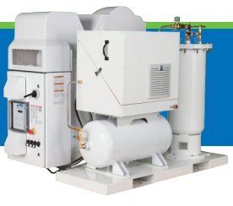
Oxygen Concentrator Unit 5.1.3.9.1

Slide 40
Oxygen Concentrator Unit

Slide 41
Oxygen Concentrator Unit

Slide 42
Oxygen Concentrator Unit

Slide 43
Oxygen Concentrator Components

Slide 44
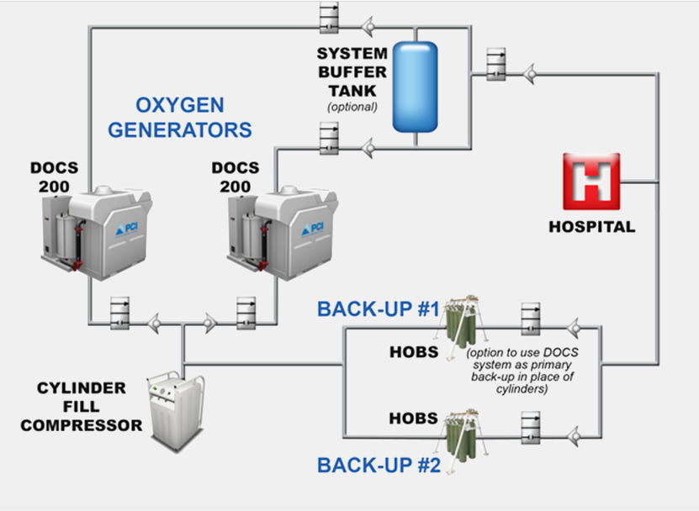

Slide 45
