Slide 1
2021 Code
5.1.3.6.1* Quality of Medical Air. Medical air shall be required to have the following characteristics:
(1) It shall be supplied from cylinders, bulk containers, or medical air compressor sources, or it shall be reconstituted from oxygen USP and oil-free, dry nitrogen NF.
(2) It shall meet the requirements of medical air USP.
(3) It shall have no detectable liquid hydrocarbons.
(4) It shall have less than 25 ppm gaseous hydrocarbons.
(5) It shall have equal to or less than 1 mg/m3 (6.85 × 10−7 lb/yd3) of permanent particulates sized 1 micron or larger in the air at normal atmospheric pressure.
5.1.3.6.2* Uses of Medical Air. Medical air sources shall be connected to the medical air distribution system only and shall be used only for air in the application of human respiration and calibration of medical devices for respiratory application.

Slide 2
5.1.3.6.3.1 Location. Medical air compressor systems shall be located per 5.1.3.3 as follows:
(1) Indoors in a dedicated mechanical equipment area, adequately ventilated and with any required utilities (e.g., electricity, drains, lighting)
5.1.3.6.3.2 Required Components. Medical air compressor systems shall consist of the following:
(2) Automatic means to prevent backflow from all on-cycle compressors through all off-cycle compressors
(5) Pressure relief valve(s) set at 50 percent above line pressure
(7) Except as defined in 5.1.3.6.3.2(1) through (6), materials and devices used between the medical air intake and the medical air source valve that are of any design or construction appropriate for the service as determined by the manufacturer

Slide 3
5.1.3.6.3.4 Compressors for Medical Air.
(2) Reciprocating compressors provided with a separation of the oil-containing section from the compression chamber by at least two seals creating an area open to atmosphere that allows the following:
(a) Direct and unobstructed visual inspection of the interconnecting shaft through vent and inspection openings no smaller than 1.5 shaft diameters in size
(3) Rotating element compressors provided with a compression chamber free of oil that provide the following:
(a) Separation of each oil-containing section from the compression chamber by at least one seal having atmospheric vents on each side with the vent closest to the oil-containing section supplied with a gravity drain to atmosphere

Slide 4
(B) For liquid ring compressors, service water and seal water shall be treated to control waterborne pathogens and chlorine from hyperchlorination from entering the medical air.
(2) Reserve medical air standby headers or a backup compressor shall be installed.
(4) When installed, the number of attached cylinders shall be Sufficient for 1 hour normal operation.
(F) Flexible connectors shall connect the air compressors with their intake and outlet piping.
5.1.3.6.3.5 Aftercoolers.
(A) Aftercoolers, where required, shall be provided with individual condensate traps.

Slide 5
5.1.3.6.3.6 Medical Air Receivers. Receivers for medical air shall meet the following requirements:
(3) They shall be equipped with a pressure relief valve, automatic drain, manual drain, sight glass, and pressure indicator.
5.1.3.6.3.7 Medical Air Dryers. Medical air dryers, where required, shall meet the following requirements:
(1) Be designed to provide air at a maximum dew point that is below the frost point [0°C (32°F)] at 345 kPa to 380 kPa (50 psi to 55 psi) at any level of demand
(2) Be sized for 100 percent of the system peak calculated demand at design conditions
5.1.3.6.3.8 Medical Air Filters. Medical air filters shall meet the following requirements:

Slide 6
(2) Be located upstream (source side) of the final line regulators
(3) Be sized for 100 percent of the system peak calculated demand at design conditions and be rated for a minimum of 98 percent efficiency at 1 micron or greater
(4) Be equipped with a continuous visual indicator showing the status of the filter element life
5.1.3.6.3.9 Piping Arrangement and Redundancies.
(D)* A medical air receiver(s) shall be provided with proper valves to allow the flow of compressed air to enter and exit out of separate receiver ports during normal operation and allow the receiver to be bypassed during service without shutting down the supply of medical air.
(E) Dryers, filters, and regulators shall be at least duplexed, with each component sized to serve the peak calculated demand with the largest of each component out of service.

Slide 7
(G) A three-way valve (three-port), indexed to flow, full port shall be permitted to be used to isolate one branch or component for the purposes of 5.1.3.6.3.9(C), 5.1.3.6.3.9(D), 5.1.3.6.3.9(E), and 5.1.3.6.3.9(F).
(I) Under normal operation, only one dryer–filter(s)–regulator sequence shall be open to airflow with the other sequence valved off.
(K) A DN8 (NPS 1∕4) valved sample port shall be provided downstream of the final line pressure regulators, dew point monitor, and carbon monoxide monitor and upstream of the source shutoff valve to allow for sampling of the medical air.
(M) Where medical air piping systems at different operating pressures are required, the piping shall separate after the filters but shall be provided with separate line regulators, dew point monitors, relief valves, and source shutoff valves.

Slide 8
5.1.3.6.3.10* Electrical Power and Control.
(3) Automatic restart function shall be included, such that the supply of medical air will resume normally after power interruption without manual intervention.
5.1.3.6.3.11 Compressor Intake.
(B) The medical air intake shall be located a minimum of 7.6 m (25 ft) from ventilating system exhausts, fuel storage vents, combustion vents, plumbing vents, vacuum and WAGD discharges, or areas that can collect vehicular exhausts or other noxious fumes.
(C) The medical air intake shall be located a minimum of 6 m (20 ft) above ground level.
(D) The medical air intake shall be located a minimum of 3.0 m (10 ft) from any door, window, or other opening in the building.

Slide 9
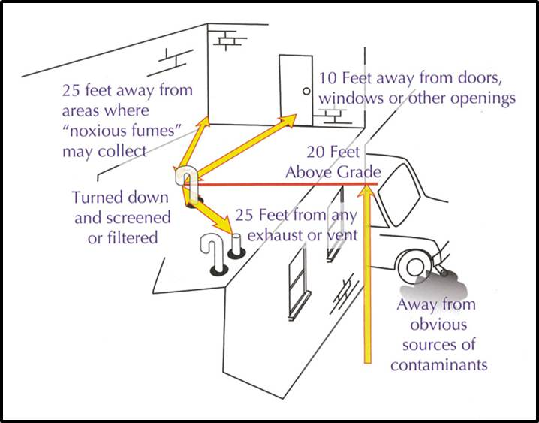

Slide 10
(E) If an air source equal to or better than outside air (e.g., air already filtered for use in operating room ventilating systems) is available, it shall be permitted to be used for the medical air compressors with the following provisions:
(1) This alternate source of supply air shall be available on a continuous 24-hour-per-day, 7-day-per-week basis.
(I) Medical air intake shall be labeled in accordance with 5.1.11.1 with any method that would distinguish it as a medical air intake.
5.1.3.6.3.12 Operating Alarms and Local Signals.
(A) A local alarm complying with 5.1.9.5 shall be provided for the medical air compressor source.
(B) Where liquid ring air compressors, compressors having water-cooled heads, or water-cooled aftercoolers are used, air receivers shall be equipped with a high water level sensor that shuts down the compressor system and activates a local alarm indicator. [See 5.1.9.5.4(8).]

Slide 11
(C) Where liquid ring compressors are used, each compressor shall have a liquid level sensor in each air–water separator that, when the liquid level is above the design level, shuts down its compressor and activates a local alarm indicator. [See 5.1.9.5.4(9).]
(D) Where nonliquid ring compressors compliant with 5.1.3.6.3.4(A)(1) are used, the air temperature at the immediate outlet of each compressor cylinder shall be monitored by a high-temperature sensor that shuts down that compressor and activates a local alarm indicator [see 5.1.9.5.4(10) ]. The temperature setting shall be as recommended by the compressor manufacturer.
(E) Where compressors compliant with 5.1.3.6.3.4(A)(2) and 5.1.3.6.3.4(A)(3) are used, the following requirements shall apply:

Slide 12
(1) The air temperature at the immediate outlet of each compressor chamber shall be monitored by a high-temperature sensor that shuts down that compressor and activates a local alarm indicator (see 5.1.9.5.4), the temperature setting shall be as recommended by the compressor manufacturer.
(2) Coalescing filters with element change indicator shall be provided.
(3) Charcoal absorber shall be provided.
(4) Gaseous hydrocarbons shall be monitored on a quarterly basis.
(F) When the capacity of the medical air system not in use is less than the equivalent capacity of one compressor, a local alarm shall activate [see 5.1.9.5.4(1)]. This signal shall require manual reset.

Slide 13
5.1.3.6.3.13 Medical Air Quality Monitoring.
(1) Dew point shall be monitored and shall activate a local alarm and all master alarms when the dew point at system delivery pressure exceeds +2°C (+35°F).
(2) Carbon monoxide shall be monitored and shall activate a local alarm when the CO level exceeds 10 ppm. [See 5.1.9.5.4(2).]
(3) Dew point and carbon monoxide monitors shall activate their individual monitor’s signal at the alarm panels where their signals are required when their power is lost.
5.1.3.6.3.14 Category 1 Medical Air Proportioning Supply Sources.
(1) Medical air reconstituted from oxygen USP and nitrogen NF, produced using proportioning system(s), shall be required to meet the following:

Slide 14
(c) The system shall produce medical air with an oxygen content of 19.5 percent to 23.5 percent.
(3) The mixture shall be analyzed continuously, and a recording capability shall be provided (e.g., via data port).
(4) The analyzing system specified in 5.1.3.6.3.14(A)(3) shall be a dedicated and an independent analyzer used to control the medical air proportioning system.
(9)* If the sources of oxygen USP and nitrogen NF that supply the medical air proportioning system are the same sources that supply the health care facility, engineering controls shall be provided to prevent cross contamination of oxygen and nitrogen supply lines, as provided in 5.1.3.5.8.
(10) A risk analysis and approval from the authority having jurisdiction shall be required.

Slide 15
(B) Location. The medical air proportioning system shall be located per 5.1.3.3 as follows:
(1) The medical air proportioning system’s supply of oxygen USP and nitrogen NF shall be located per 5.1.3.3 and NFPA 55, as applicable.
(C) Required Components. The medical air proportioning system shall consist of the following:
(a) The supply lines shall be filtered to remove particulate entering the proportioning system.
(9)* Warning systems per 5.1.9, including a local signal and master alarm that indicates nonconforming oxygen concentration per manufacturer’s recommendations

Slide 16
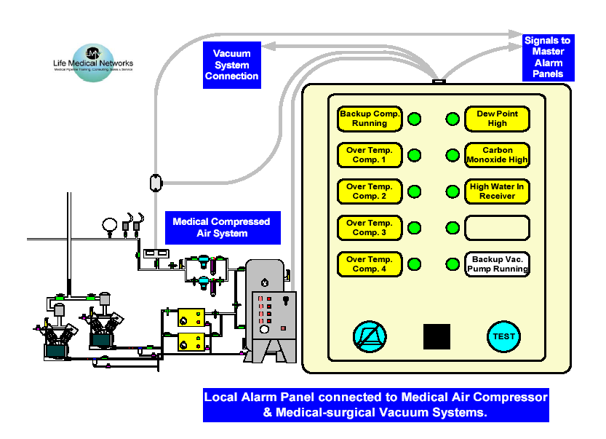
1. Connected Medical Pipeline Source Equipment
3. Signals From Other Source Equipment
2. Required Medical Air System Signals
5. Test Button
4. Cancelable Audible Indicator

Slide 17
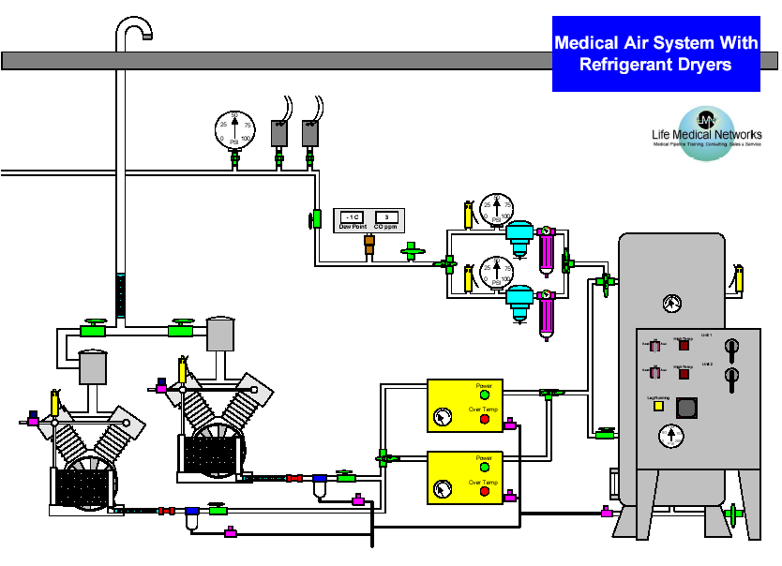
1. Air intake
12. Main Line Pressure High & Low
13. Main Line Gauge
8. Delivery
Relief-valve
7. Final Filters & Pressure Regulators
11. Source Valve
6. Receiver
10. Medical Air Quality Monitor
2. Compressors
9. Sample Port
5. Electrical
Controls
4. Dryers
3. After-coolers

Slide 18
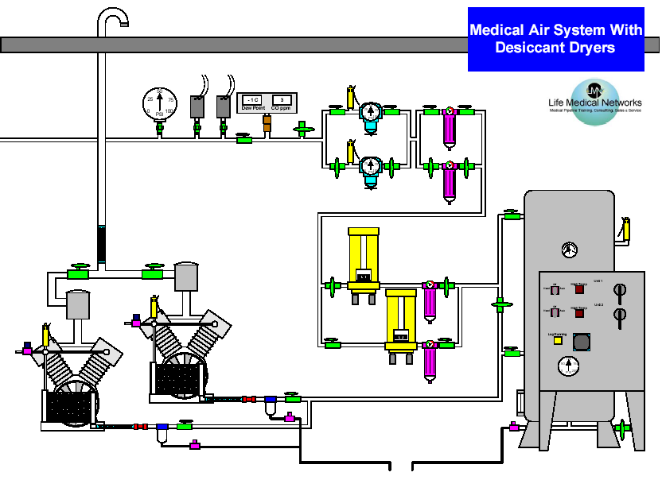
1. Air intake
8. Delivery
Relief-valve
13. Main Line Gauge
12. Main Line Pressure High & Low
10. Medical Air Quality Monitor
11. Source Valve
9. Sample Port
6. Receiver
7. Final Filters & Pressure Regulators
2. Compressors
3. After-coolers
4. Dryers
5. Electrical
Controls

Slide 19
9. Intake Piping
10. Air Quality Monitors
6. Final Line Relief Valve
4. Final Delivery Regulators
7. 1/4” Sample Port
1. Receiver
3. Final Filters
2. Medical Air Dryers
8. Control Panel
5. Component Redundancy Piping

Slide 20
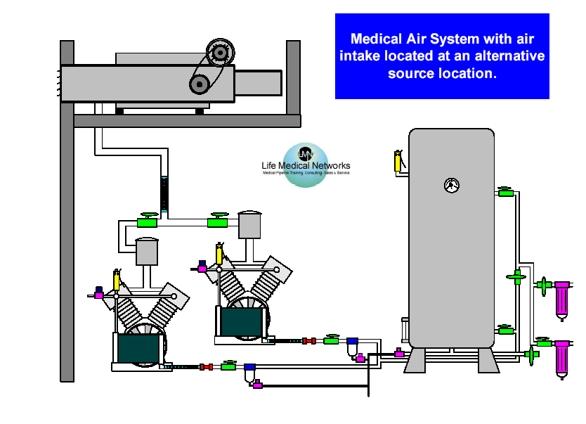
1. Alternative Medical Air System Intake

Slide 21
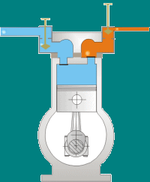
Typical Reciprocating Compressor
Notes:
Animated Compressor Operation

Slide 22
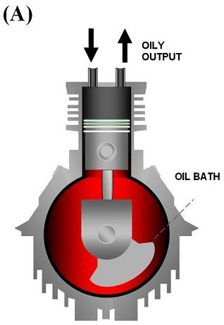
Notes:
Standard air compressor – not medical air compressor

Slide 23
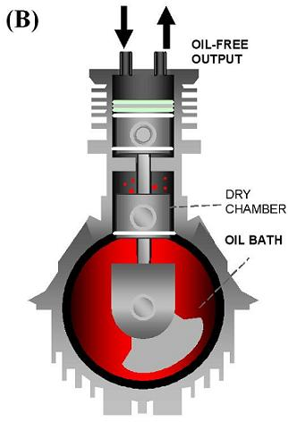
Notes:
Oil free compressor

Slide 24
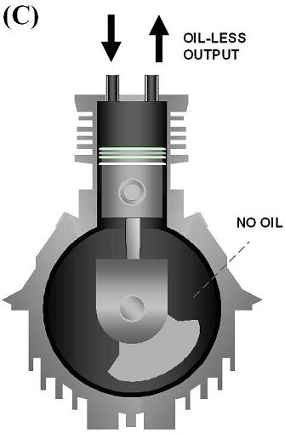
Notes:
Oil-less compressor

Slide 25
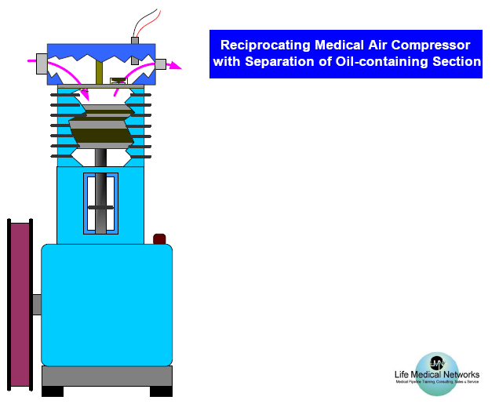
4. High Exhaust Temperature Sensor
3. Compression Section
2. Separation Section
1. Oil Containing Section

Slide 26
2. Compressor Intake Connection
6. High Exhaust Temperature Sensor
1. Flexible Connectors
3. Compressor Material Requirements
5. Anti-vibration Mounts
4. Aftercoolers & Condensate Trap

Slide 27
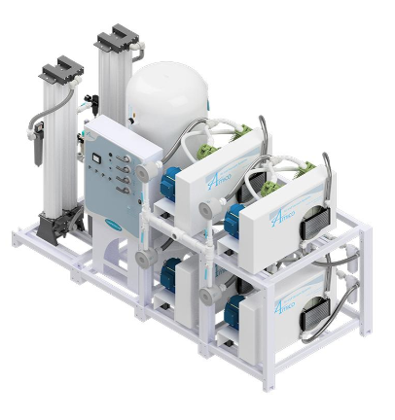
Medical Air reciprocating compressor

Slide 28
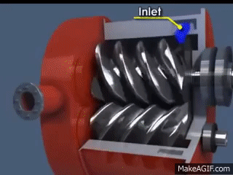
Scroll Compressor
Notes:
Animated Scroll Operation

Slide 29
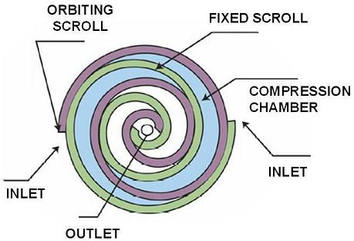

Slide 30
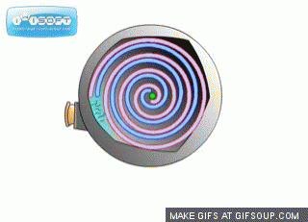
Orbiting Scroll Compressor
Notes:
Animated Compressor Operation

Slide 31
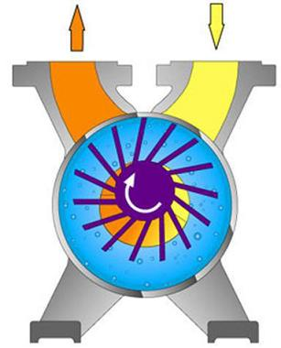
Liquid Ring Compressor

Slide 32
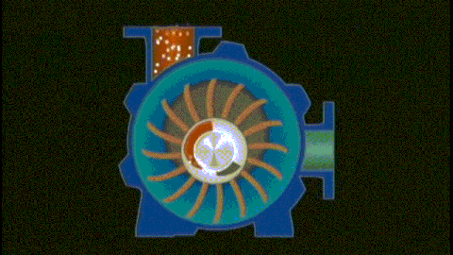
Liquid Ring Compressor
Notes:
Animated Liquid Ring Operation

Slide 33
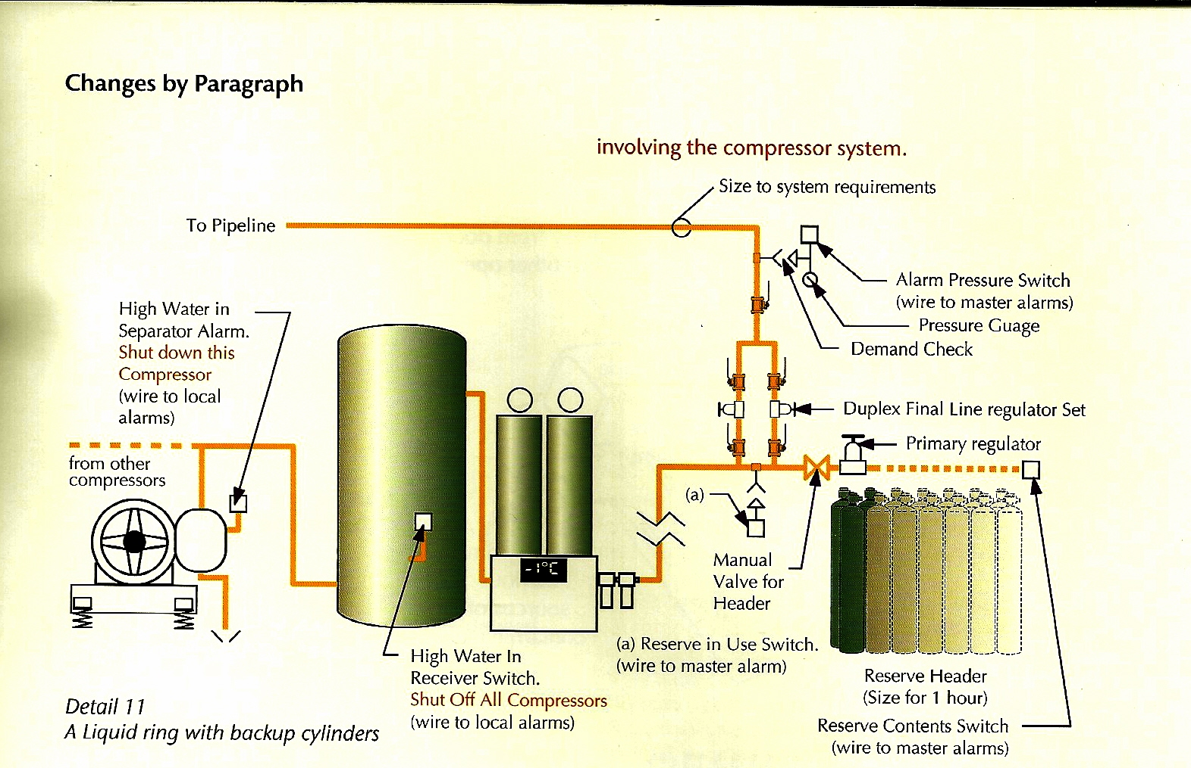
Liquid Ring Compressor

