Slide 1
NFPA 99 2021
5.1.1.2 Category 1 piped gas or piped vacuum system requirements shall be applied where any of the following criteria is met:
(1) General anesthesia or deep sedation is performed as defined in 3.3.68.1 and 3.3.68.2.
(2) The loss of the piped gas or piped vacuum systems is likely to cause major injury or death of patients, staff, or visitors.
5.1.1.4 An existing system that is not in strict compliance with the provisions of this code shall be permitted to be continued in use, unless the authority having jurisdiction has determined that such use does not constitutes a distinct hazard to life.

Slide 2
5.1.1.6 Category 1 systems shall be permitted to serve spaces identified as Category 1, Category 2, or Category 3.
5.1.3.1 Central Supply System Identification and Labeling.
5.1.3.1.1* Cylinders, containers, and tanks shall be designed, fabricated, tested, and marked (stamped) in accordance with regulations of DOT, Transport Canada (TC) Transportation of Dangerous Goods Regulations, or the ASME Boiler and Pressure Vessel Code, “Rules for the Construction of Unfired Pressure Vessels,” Section VIII. [55:7.1.5.1]

Slide 3
5.1.3.1.2* Cylinder contents shall be identified by attached labels or stencils naming the contents in accordance with the mandatory requirements of CGA C-7, Guide to Classification and Labeling of Compressed Gases.
5.1.3.1.3 Liquid containers shall have additional product identification visible from all directions with a minimum of 51 mm (2 in.) high letters such as a 360-degree wraparound tape for medical liquid containers.
5.1.3.1.4 Cryogenic liquid containers shall be provided with gas-specific outlet connections in accordance with the mandatory requirements of CGA V-5, Diameter-Index Safety System (Noninterchangeable Low Pressure Connections for Medical Gas Applications), or CGA V-1, Standard for Compressed Gas Cylinder Valve Outlet and Inlet Connections.

Slide 4
5.1.3.1.5 Cylinder and cryogenic liquid container outlet connections shall be affixed in such a manner as to be integral to the valve(s), unremovable with ordinary tools, or so designed as to render the attachment point unusable when removed.
5.1.3.1.7 Labels shall not be defaced, altered, or removed, and connecting fittings shall not be modified.
5.1.3.1.8 Source Locations containing positive pressure gases other than oxygen and medical air shall have their doors labeled as follows:
Positive Pressure Gases
NO Smoking or Open Flame
Room May Have Insufficient Oxygen
Open Door and Allow Room to Ventilate Before Entering

Slide 5
5.1.3.1.8.1 Existing signage that is not in strict compliance with the provisions of this code shall be permitted to be continued in use as long as the authority having jurisdiction has determined that such use does not constitute a distinct hazard to life.
5.1.3.1.9 Source locations containing only oxygen or medical air shall have their doors labeled as follows:
Medical Gases NO Smoking or Open Flame
5.1.3.1.9.1 Existing signage that is not in strict compliance with the provisions of this code shall be permitted to be continued in use as long as the authority having jurisdiction has determined that such use does not constitute a distinct hazard to life.

Slide 6
5.1.3.2.1 The use of adapters or conversion fittings to adapt one gas-specific fitting to another shall be prohibited.
5.1.3.2.6 Cylinders without correct markings or whose markings and gas-specific fittings do not match shall not be used.
5.1.3.2.11 Cylinders in use and in storage shall be prevented from reaching temperatures in excess of 52°C (125°F).
5.1.3.2.12 Central supply systems for nitrous oxide and carbon dioxide using cylinders or portable containers shall be prevented from reaching temperatures lower than the recommendations of the central supply system’s manufacturer, but shall never be lower than −7°C (20°F) or greater than 52°C (125°F).

Slide 7
5.1.3.3.1.1 Any of the following central supply systems shall be
permitted to be located together in the same outdoor enclosure:
(1) Manifolds for gas cylinders (see 5.1.3.5.10)
(2) Manifolds for cryogenic liquid containers (see 5.1.3.5.11)
(3) Cryogenic fluid central supply (see 5.1.3.5.12)
(4)* Individual components on the oxygen side of concentrator sources (see 5.1.3.9)
5.1.3.3.1.2 Any of the following systems shall be permitted to be located together in the same indoor enclosure:
(1) Manifolds for gas cylinders (see 5.1.3.5.10)
(2) Manifolds for cryogenic liquid containers (see 5.1.3.5.11)
(3) In-building emergency reserves (see 5.1.3.5.14)
(4) Instrument air standby headers (see 5.1.13.3.7.6)
(5)* Individual components on the oxygen side of concentrator sources (see 5.1.3.9)

Slide 8
5.1.3.3.1.3 Any of the following central supply systems shall be permitted to be located together in the same room:
(1) Medical air central supply compressor supply sources (see 5.1.3.6.3)
(2) Medical–surgical vacuum central supply sources (see 5.1.3.7)
(3) Waste anesthetic gas disposal (WAGD) central supply sources (see 5.1.3.8)
(4) Instrument air compressor central supply sources (see 5.1.13.3.7)
(5) Any other compressor, vacuum pump, or electrically powered machinery
(6)* Compressors, dryers, and air receivers used to supply oxygen concentrators (see 5.1.3.9)
(7) Concentrator units with air and oxygen sides in an integral unit (see 5.1.3.9)

Slide 9
5.1.3.3.1.4 Any central supply system listed under 5.1.3.3.1.3 shall not be located in the same room with any central supply system listed under 5.1.3.3.1.1 or 5.1.3.3.1.2, except instrument air reserve headers complying with 5.1.3.2.12 and 5.1.13.3.4.6 shall be permitted to be in the same room as an instrument air compressor.
5.1.3.3.1.5 Indoor locations for oxygen, nitrous oxide, and mixtures of these gases shall not communicate with the following:
(1) Areas involved in critical patient care
(2) Anesthetizing locations where moderate sedation, deep sedation, or general anesthesia is administered
(3) Locations storing flammables
(4) Rooms containing open electrical contacts or transformers
(5) Storage tanks for flammable or combustible liquids
(6) Engines
(7) Kitchens
(8) Areas with open flames

Slide 10
5.1.3.3.1.6 Cryogenic fluid central supply systems for oxygen shall comply with NFPA 55.
5.1.3.3.1.7 Bulk nitrous oxide central supply systems shall comply with NFPA 55 and with the mandatory requirements of CGA G-8.1, Standard for Nitrous Oxide Systems at Customer Sites.
5.1.3.3.1.8 Central supply systems for carbon dioxide using permanently installed containers with product capacities greater than 454 kg (1000 lb) shall comply with NFPA 55 and with the mandatory requirements of CGA G-6.1, Standard for Insulated Carbon Dioxide Systems at Consumer Sites.
5.1.3.3.1.9 Central supply systems for carbon dioxide using permanently installed containers with product capacities of 454 kg (1000 lb) or less shall comply with NFPA 55 and with the mandatory requirements of CGA G-6.5, Standard for Small, Stationary, Insulated Carbon Dioxide Supply Systems.

Slide 11
5.1.3.3.1.10* Cryogenic fluid central supply systems for inert gases shall comply with NFPA 55 and with the mandatory requirements of CGA P-18, Standard for Bulk Inert Gas Systems at Consumer Sites.
5.1.3.3.2* Design and Construction.
5.1.3.3.2.1Locations for central supply systems and the storage of positive-pressure gases shall meet the following requirements:
(1) They shall be constructed with access to move cylinders, equipment, and so forth, in and out of the location on hand trucks complying with 11.4.3.1.1.
(2) They shall be provided with lockable doors or gates or otherwise able to be secured.
(3) If outdoors, they shall be well drained and provided with an enclosure (e.g., wall or fencing) constructed of noncombustible materials.
(4) If outdoors, cylinders and containers shall be protected from prolonged contact with soil.

Slide 12
(5) If indoors, they shall have interior finishes of noncombustible or limited-combustible materials.
(6) If indoors, rooms containing oxygen, nitrous oxide, or other oxidizers shall be separated from the rest of the building by walls and floors having a 1-hour fire resistance rating with doors and other opening protectives having a ³∕ ₄-hour fire protection rating.
(7)* They shall comply with NFPA 70 for ordinary locations.
(8)* Fuel-fired equipment shall not be located in the room.
(9) If they require heat, the maximum allowable temperature of the in-room heating element shall be 130°C (266°F).
(10) They shall be provided with racks, chains, or other fastenings to secure all cylinders from falling, whether connected, unconnected, full, or empty.

Slide 13
(11)* They shall be supplied with electrical power compliant with the requirements for essential electrical systems as described in Chapter 6.
(12) They shall have racks, shelves, and supports, where provided, constructed of noncombustible materials or limited-combustible materials.
(13) They shall protect electrical devices from physical damage.
(14)* They shall allow access by delivery vehicles and management of cylinders.
(15) They shall be designed to meet the operational requirements of 5.1.3.2 with regard to room temperature.

Slide 14
5.1.3.3.3 Ventilation.
5.1.3.3.3.1 Ventilation for Indoor Locations. Central supply system locations, medical gas storage rooms, and transfilling room ventilation shall comply with 9.3.6.
9.3.6.5.2 Natural Ventilation.
9.3.6.5.2.1 Natural ventilation shall consist of two nonclosable louvered openings, each having an aggregate free opening area of at least 155 cm²/35 L (24 in.²/1000 ft³) of the fluid designed to be stored in the space and in no case less than 465 cm² (72 in.²).
9.3.6.5.2.2 One opening shall be located within 30 cm (1 ft) of the floor, and one shall be located within 30 cm (1 ft) of the ceiling.
9.3.6.5.3 Mechanical Ventilation.
9.3.6.5.3.1 Mechanical exhaust to maintain a negative pressure in the space shall be provided continuously, unless an alternative design is approved by the authority having jurisdiction.
9.3.6.5.3.2 Mechanical exhaust shall be at a rate of 1 L/sec of airflow for each 300 L (1 cfm per 5 ft³ of fluid) designed to be stored in the space and not less than 24 L/sec (50 cfm) nor more than 235 L/sec (500 cfm).

Slide 15
5.1.3.3.3.4 Ventilation for Outdoor Locations.
(1) Outdoor locations surrounded by impermeable walls, except fire barrier walls, shall have protected ventilation openings located at the base of each wall to allow free circulation of air within the enclosure.
(2) Walls that are shared with other enclosures or with buildings shall be permitted to not have openings.
(3) The fire barrier wall shall not have openings or penetrations, except conduit or piping shall be permitted, provided that the penetration is protected with a firestop system in accordance with the building code.

Slide 16
5.1.3.3.4 Storage.
5.1.3.3.4.1 Full or empty medical gas cylinders, when not connected, shall be stored in locations complying with 5.1.3.3.2 through 5.1.3.3.3 and shall be permitted to be in the same rooms or enclosures as their respective central supply systems.
5.1.3.4 Control Equipment. For control equipment, as specified in 5.1.3.5.5, 5.1.3.5.6, and 5.1.3.5.7, that is physically remote from the supply system, the control equipment shall be installed within a secure enclosure to prevent unauthorized access in accordance with 5.1.3.3.1(2).
5.1.3.5.2 Permitted Locations for Medical Gases. Central supply systems for oxygen, medical air, nitrous oxide, carbon dioxide, and all other patient medical gases shall be piped only to medical gas outlets complying with 5.1.5, into areas where the gases will be used under the direction of licensed medical professionals for purposes congruent with the following:

Slide 17
5.1.3.5.3 Medical Support Gases. Central supply systems for support gases shall not be piped to, or used for, any purpose except medical support application.
5.1.3.5.4* Materials. Materials used in central supply systems shall meet the following requirements:
(1) In those portions of systems intended to handle oxygen at gauge pressures greater than 2413 kPa (350 psi), interconnecting hose shall contain no polymeric materials.
(2) In those portions of systems intended to handle oxygen or nitrous oxide material, construction shall be compatible with oxygen under the temperatures and pressures to which the components can be exposed in the containment and use of oxygen, nitrous oxide, mixtures of these gases, or mixtures containing more than 23.5 percent oxygen.

Slide 18
5.1.3.5.5 Controls for Line Pressure.
5.1.3.5.5.1* All positive-pressure supply systems shall be provided with means to control the final line pressure at the source with all the following characteristics:
(1) Able to maintain stable pressures within the limits of Table 5.1.11
(2) Each control mechanism able to flow 100 percent of the peak calculated demand.
(3) Redundant, such that each component of the control mechanism can be isolated for service or replacement while maintaining normal operation.
(4) Protected against overpressure (see 5.1.3.5.6).
(5) Be constructed of materials deemed suitable by the manufacturer.
5.1.3.5.5.2 The line pressure regulators required under 5.1.3.5.5.1, where used for cryogenic fluid crntral supply systems, shall be of a balanced design

Slide 19
5.1.3.5.6 Relief Valves.
5.1.3.5.6.1 All pressure relief valves shall meet the following requirements:
(1) They shall be of brass, bronze, or stainless steel construction.
(2) They shall be designed for the specific gas service.
(3) They shall have a relief pressure setting not higher than the maximum allowable working pressure (MAWP) of the component with the lowest working pressure rating in the portion of the system being protected.
(4) They shall be vented to the outside of the building, except that relief valves for compressed air systems having less than 84,950 L (3000 ft³) at STP shall be permitted to be diffused locally by means that will not restrict the flow.
(5) They shall have a vent discharge line that is not smaller than the size of the relief valve outlet or 20mm (3/4 NPS) whichever is larger.

Slide 20
(6) Where two or more relief valves discharge into a common vent line, the internal cross-sectional area of the common line shall be not less than the aggregate cross-sectional area of all relief valve vent discharge lines served.
(7) They shall not discharge into locations creating potential hazards.
(8) They shall have the discharge terminal turned down and screened to prevent the entry of rain, snow, or vermin.
(9) They shall be designed in accordance with ASME B31.3, Pressure Process Piping.
5.1.3.5.6.2 Pressure relief valves for cryogenic fluid central supply systems shall be in accordance with 5.1.3.10.10.
5.1.3.5.6.3 When vented to outdoors, materials and construction for relief valve discharge lines shall be the same as required for positive pressure gas distribution. (See 5.1.10.1.)

Slide 21
5.1.3.5.6.4 Central supply systems for positive pressure gases shall include one or more relief valves, all meeting the following requirements:
(1) They shall be located between each final line regulator and the source valve.
(2) They shall have a relief setting that is 50 percent above the normal system operating pressure, as indicated in Table 5.1.11.
5.1.3.5.7 Multiple Pressures.
Where a single central supply system supplies separate piped distribution networks operating at different pressures, each piped distribution network shall comply with 5.1.3.5.5 for pressure controls, 5.1.3.5.6 for relief valves, 5.1.4.2 for the source valve, and 5.1.9.2.4(7) for the master alarm.

Slide 22
5.1.3.5.8 Local Signals.
5.1.3.5.8.1 The following central supply systems shall have local signals located at the source equipment:
(1) Manifolds for gas cylinders without reserve supply (see 5.1.3.5.12)
(2) Manifolds for gas cylinders with reserve supply
(3) Manifolds for cryogenic liquid containers (see 5.1.3.5.13)
(4) Cryogenic fluid central supply systems (see 5.1.3.5.12)
(5) In-building emergency reserves (see 5.1.3.5.14)

Slide 23
(6) Instrument air headers (see 5.1.13.3.7.6)
5.1.3.5.9* Headers. In central supply systems using cylinders containing either gas or liquid, each header shall include the following:
(1)* Cylinder connections in the number required for the header’s application
(2) Cylinder lead for each cylinder constructed of materials complying with 5.1.3.5.4 and provided with end fittings permanently attached to the cylinder lead complying with the mandatory requirements of CGA V-1, Standard for Compressed Gas Cylinder Valve Outlet and Inlet Connections (ANSI B57.1)
(3) Filter of a material complying with 5.1.3.5.4 to prevent the intrusion of debris into the manifold controls

Slide 24
(4) Header shutoff valve downstream of the nearest cylinder connection, but upstream of the point at which the header connects to the central supply system
(5) Pressure indicator indicating the pressure of header contents
(6) Check valve to prevent backflow into the header and to allow service to the header
(7) If intended for gas cylinder service, a check valve at each connection for the cylinder lead in 5.1.3.5.10(2) to prevent loss of gas in the event of damage to the cylinder lead or operation of an individual cylinder relief valve
(8) If intended for gas cylinder service, a pressure regulator to reduce the cylinder pressure to an intermediate pressure to allow the proper operation of the primary and secondary headers
(9) If intended for service with cryogenic liquid containers, a pressure relief valve

Slide 25
(10) Vent valves, if fitted on a header, vented outside of the building per 5.1.3.5.6.1(5) through 5.1.3.5.6.1(9) and 5.1.3.5.6.3
5.1.3.5.10 * Manifolds for Gas Cylinders.
5.1.3.5.10.1 The manifolds in this category shall be located in accordance with 5.1.3.3.1 and shall meet the following:
(1) If located outdoors, they shall be installed in an enclosure used only for this purpose and sited to comply with minimum distance requirements in Table 5.1.3.5.11.1.
(2) If located indoors, they shall be installed within a room used only for enclosure of such manifolds.

Slide 26
5.1.3.5.10.4 The manifolds in this category shall consist of the following:
(1) Two equal headers in accordance with 5.1.3.5.9, each with a sufficient number of gas cylinder connections for one average day’s supply, but not fewer than two connections, and with the headers connected to the final line pressure regulator assembly in such a manner that either header can supply the system
5.1.3.5.10.5 The manifolds in this category shall include an automatic means of alternating the two headers to accomplish the following in normal operation:
(1) One header is the primary and the other is the secondary, with either being capable of either role.

Slide 27
(3) When the primary header is depleted, the secondary header automatically begins to supply the system.
Table 5.1.3.5.11.1 Minimum Separation Distance Between Portable Cryogenic Containers and Exposures
5.1.3.5.11.4 The manifolds in this category shall consist of the following:
(1) Two equal headers in accordance with 5.1.3.5.9, each having sufficient internal or external vaporization capacity to meet the required peak flow rate and each having sufficient number of liquid container connections for one average day’s supply, and with the headers connected to the final line pressure regulator assembly in such a manner that either header can supply the system

Slide 28
Headers & Manifolds

Slide 29
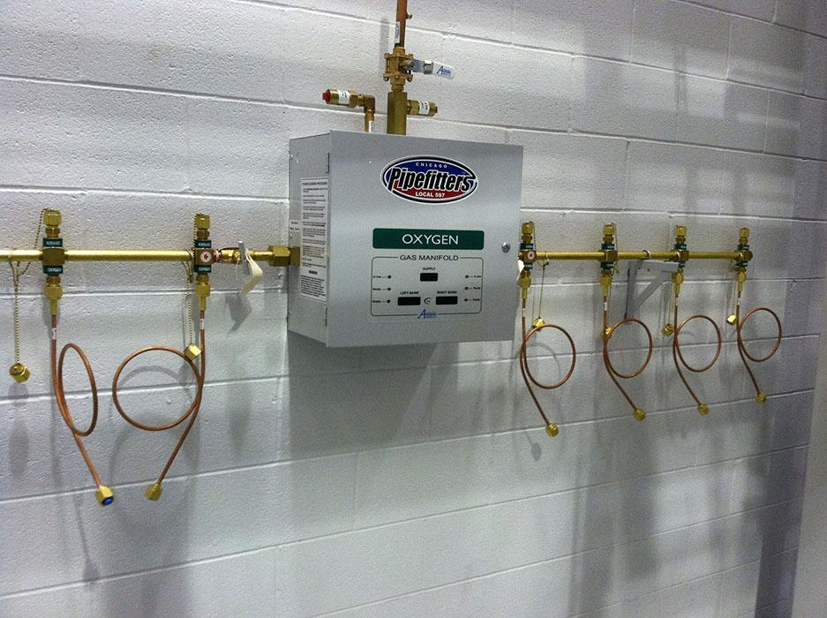

Slide 30
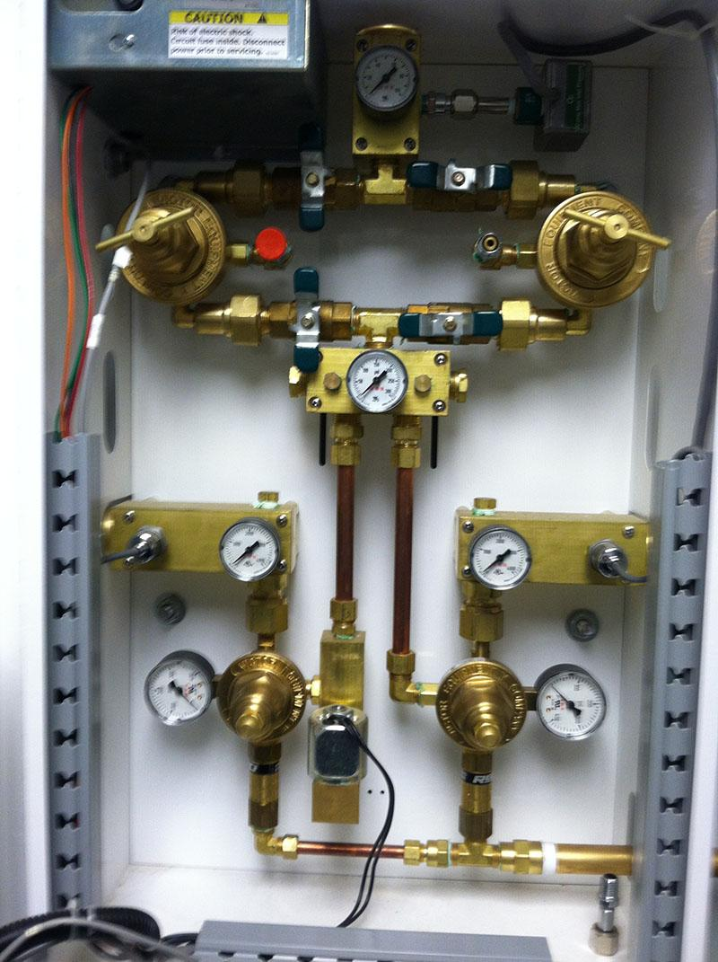

Slide 31
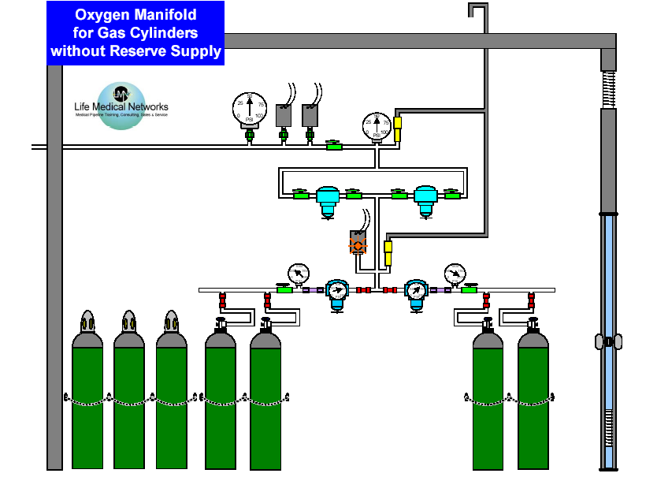
8. Relief-valve venting
10. Main-line, Pressure Switches
6. Pressure Indicator
7. Delivery, Pressure Relief-valve
11. Main-line, Pressure Gauge
9. Source Valve
4. Secondary Supply in Use
5. Dual, Final-line Regulators
3. Intermediate Relief-valve
2. Operation of Primary and Secondary Supplies
1. Two Equal Headers

Slide 32
Outdoor Location Weatherproof Enclosure

Slide 33
Weatherproof Enclosure

Slide 34
Genesys™ Manifolds
Captured (non-removable) CGA V-1 fitting

Slide 35
Genesys™ Manifolds
Captured (non-removable) CGA V-1 fitting

Slide 36
Genesys™ Manifolds
Captured (non-removable) CGA V-1 fitting
No polymeric materials > 350 psig in O2 service

Slide 37
(2) Reserve header in accordance with 5.1.3.5.9 having sufficient number of gas cylinder connections for one average day’s supply, but not fewer than three connections, and connected downstream of the primary/secondary headers and upstream of the final line pressure regulators
(3) Pressure relief installed downstream of the connection of the reserve header and upstream of the final line pressure regulating assembly and set at 50 percent above the nominal inlet pressure
(4) If provided with one liquid container header (primary), one gas cylinder header (secondary), and a reserve gas cylinder header (a hybrid arrangement), a secondary gas cylinder supply having equal capacity to meet the required peak flow rate of the primary header, and a reserve gas cylinder header in accordance

Slide 38
with 5.1.3.5.9 having sufficient number of gas cylinder connections for one average day's supply, but not fewer than three connections
5.1.3.5.11.5 The manifolds in this category shall include an automatic means of controlling the three headers to accomplish the following during normal operation:
(1) If provided with two liquid container headers, one cryogenic liquid header shall be the primary and the other shall be the secondary, with either being capable of either role.
(2) If provided with one liquid container header and one gas cylinder header (a hybrid arrangement), the liquid container header is the primary and the gas cylinder header is the secondary

Slide 39
5.1.3.5.11.6 The manifolds in this category shall be equipped with a means to conserve the gas produced by evaporation of the cryogenic liquid in the secondary header (when so provided). This mechanism shall discharge the conserved gas into the system upstream of the final line regulator assembly.
5.1.3.5.11.9 The manifolds in this category shall have a local signal that visibly indicates the operating status of the equipment and activates an indicator at all master alarms under the following conditions:
(1) When or at a predetermined set point before the secondary header begins to supply the system, indicating changeover
(2) Where a hybrid arrangement is employed, when or at a predetermined set point before the secondary (cylinder) header contents fall to one average day’s supply, indicating secondary low

Slide 40
(3) When or at a predetermined set point before the reserve header begins to supply the system, indicating reserve is in use
(4) When or at a predetermined set point before the reserve header contents fall to one average day’s supply, indicating reserve low
5.1.3.5.12 Cryogenic Fluid Central Supply Systems.
The storage, use, and handling of cryogenic fluid central supply systems that deliver compressed medical gases (CMGs) to health care facilities shall be in accordance with 5.1.3.10.

Slide 41
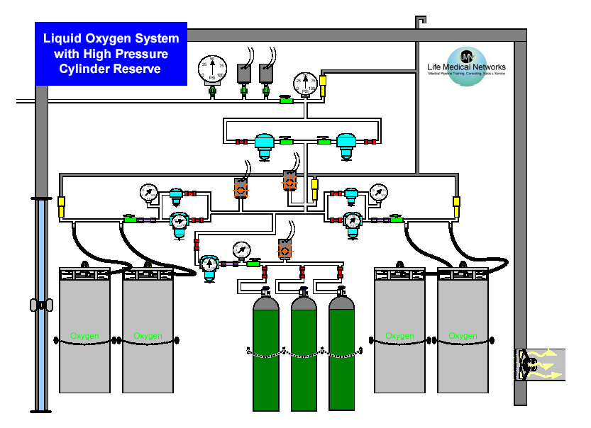
4. Economy Regulators
5. Secondary Supply in Use
6. Reserve Supply in Use
3. Operation of Primary and Secondary Supplies
7. Reserve Supply Low
1. Two Equal Headers
2. Reserve,
High-pressure
Cylinder Supply

Slide 42
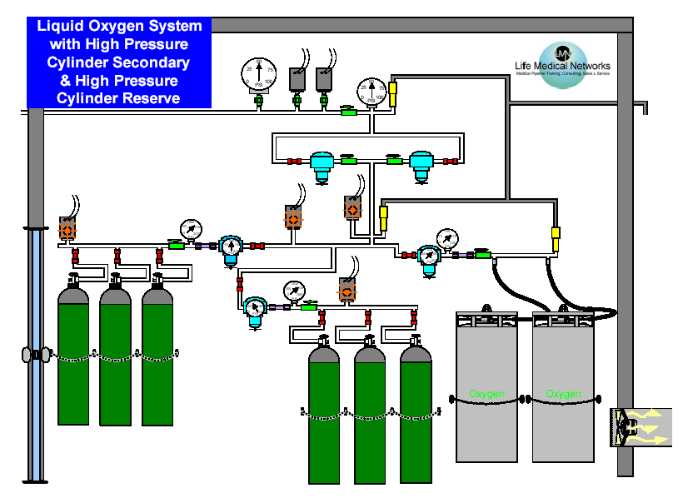
3. Operation of Primary and Secondary Supplies
6. Secondary Supply Low
5. Secondary Supply in Use
7. Reserve Supply in Use
8. Reserve Supply Low
4. Gas Conservation
1. Two Equal Headers
2. Reserve,
High-pressure
Cylinder Supply

Slide 43
5.1.3.5.13* Emergency Oxygen Supply Connection (EOSC).
Emergency oxygen supply connections (EOSCs) shall be installed to allow connection of a temporary auxiliary source of supply for emergency or maintenance situations where either of the following conditions exist:
(1) The bulk liquid system or cryogenic fluid central supply system is outside of and remote from the building that the oxygen supply serves, and there is no connected in-building oxygen reserve sufficient for one average day’s supply. (See 5.1.3.5.14 for requirements for such reserves.)

Slide 44
(2) Multiple freestanding buildings are served from a single oxygen source such that damage to the interconnecting oxygen line could result in one or more buildings losing oxygen supply, in which case each building is required to be provided with a separate emergency connection.
5.1.3.5.13.1 EOSCs shall be located as follows:
(1) Located on the exterior of the building being served in a location accessible by emergency supply vehicles at all times in all weather conditions
(2) Connected to the main supply line immediately downstream of the main shutoff valve
5.1.3.5.13.2 EOSCs shall consist of the following:
(1) Physical protection to prevent unauthorized tampering

Slide 45
(2) Female DN (NPS) inlet for connection of the emergency oxygen source that is sized for 100 percent of the system demand at the emergency source gas pressure
(3) Manual shutoff valve to isolate the EOSC when not in use
(4) Two check valves, one downstream of the EOSC and one downstream of the main line shutoff valve, with both upstream from the tee connection for the two pipelines
(5) Relief valve sized to protect the downstream piping system and related equipment from exposure to pressures in excess of 50 percent higher than normal line pressure
(6) Any valves necessary to allow connection of an emergency supply of oxygen and isolation of the piping to the normal source of supply
(7) Minimum of 1 m (3 ft) of clearance around the EOSC for connection of temporary auxiliary source

Slide 46
5.1.3.5.13 Emergency Oxygen Supply Connection (EOSC)
The following shall apply:
Required when Bulk Liquid supply is remote
Located on the exterior of each building being served
Must be physically protected from damage & secured from unauthorized access
Must have minimum 3 ft. of clearance for connection of temporary emergency source
Must be accessible by emergency supply vehicles at all times and in all weather conditions

Slide 47
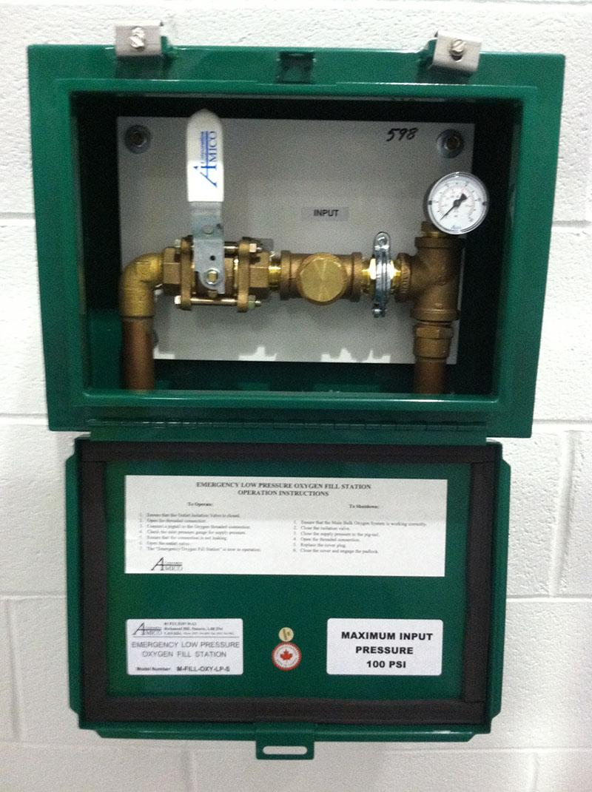

Slide 48
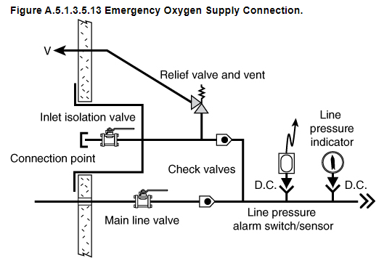
EOSC
Notes:
Page 168

Slide 49
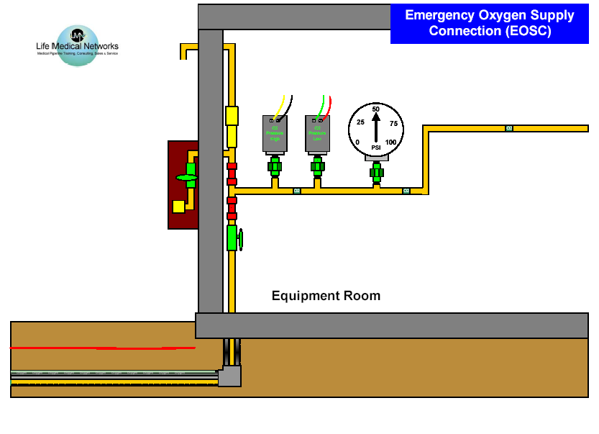
3. EOSC Location
4. Tamper Proof Housing
10. Main Line
Pressure Gauge
8. Pressure Relief-valve
9. Main Line Pressure High & Low
6. Manual Shutoff Valve
7. Check Valves
5. Female NPT Inlet
2. Main Line Valve
11. Piping Labeling
1. Underground Medical Piping

Slide 50
(8)* Four alarm connection points installed to both master alarm panels to allow the temporary supply to be monitored while in use
5.1.3.5.14 In-Building Emergency Reserves (IBERs).
5.1.3.5.14.1 IBERs shall not be used as substitutes for the bulk gas reserve system that is required in 5.1.3.5.14.3.
5.1.3.5.14.2 When an IBER is provided inside the building as a substitute for the EOSC or for other purposes, it shall be located in accordance with 5.1.3.3 as follows:
5.1.3.5.14.3 IBERs shall consist of either of the following:
(1) Gas cylinder header per 5.1.3.5.10 with sufficient cylinder connections to provide for at least one average day’s supply with the appropriate number of connections being determined after consideration of the delivery schedule, the proximity of the facility to alternate supplies, and the facility’s emergency plan

Slide 51
5.1.3.5.14.5 IBERs shall have a local signal that visibly indicates the operating status of the equipment and an alarm at all master alarms when or just before the reserve begins to serve the system.

Slide 52
Piping Example

Slide 53
Mechanical Room Example

