Slide 1
2021 Code
5.1.3.10 * Cryogenic Fluid Central Supply Systems.
5.1.3.10.1 General.
5.1.3.10.1.1 * The storage, use, and handling of cryogenic fluid central supply systems that deliver compressed medical gases (CMGs) to health care facilities shall be in accordance with the requirements of this section. [55:17.1.1]
5.1.3.10.1.2 Applicability.
(A) The source valve shall be the line separating the applicability between NFPA 55 and this code. [55:17.1.2.1]
(B) Cryogenic fluid central supply system installations up to, but not including, the source valve shall be covered by NFPA 55. [55:17.1.2.2]
(C) The source valve and all downstream piping and components, including wiring to storage system alarms, shall be covered by this code. [55:17.1.2.3]

Slide 2
5.1.3.10.2 Cryogenic Fluid Central Supply Systems Installation.
5.1.3.10.2.1 Cryogenic fluid central supply systems shall be installed by personnel qualified in accordance with CGA M-1, Standard for Medical Gas Supply Systems at Health Care Facilities, or ASSE 6015, Professional Qualifications Standard for Bulk Medical Gas Systems Installers. [55:17.2.1]
5.1.3.10.2.2 Cryogenic fluid central supply systems shall be installed in compliance with the Food and Drug Administration (FDA) Current Good Manufacturing Practices per 21 CFR 210 and 21 CFR 211. [55:17.2.2]
5.1.3.10.2.3 Cryogenic fluid central supply systems shall be anchored with foundations in accordance with CGA M-1, Standard for Medical Gas Supply Systems at Health Care Facilities. [55:17.2.3]

Slide 3
5.1.3.10.2.4 Cryogenic fluid central supply systems shall have a minimum work space clearance of 3 ft (1 m) around three sides of the storage container, three sides of the vaporizer(s), and the cabinet opening or front side of the pressure-regulating manifold for system maintenance and operation.
5.1.3.10.2.5 Inert cryogenic fluid central supply systems shall be sited in accordance with Chapter 8 of NFPA 55 and CGA P-18, Standard for Bulk Inert Gas Systems at Consumer Sites. [55:17.2.5]
5.1.3.10.2.6 Oxygen cryogenic fluid central supply systems shall be sited in accordance with Chapters 8 and 9 of NFPA 55, as applicable, and CGA M-1, Standard for Medical Gas Supply Systems at Health Care Facilities. [55:17.2.6]

Slide 4
5.1.3.10.2.7 Carbon dioxide refrigerated liquid central supply systems shall be sited in accordance with Chapter 13 of NFPA 55 and CGA G-6.1, Standard for Insulated Liquid Carbon Dioxide Systems at Consumer Sites. [55:17.2.7]
5.1.3.10.2.8 Nitrous oxide refrigerated liquid central supply systems shall be sited in accordance with Chapter 16 of NFPA 55 and CGA G-8.1, Standard for Nitrous Oxide Systems at Customer Sites. [55:17.2.8]
5.1.3.10.3 Cryogenic Fluid Central Supply Systems Operation.
5.1.3.10.3.1 The following components of the cryogenic fluid central supply system shall be accessible and visible to delivery personnel during filling operations:

Slide 5
(1) Fill connection
(2) Top and bottom fill valves
(3) Hose purge valve
(4) Vent valve
(5) Full trycock valve
(6) Liquid level indicator
(7) Tank pressure indicator [55:17.3.1]
5.1.3.10.3.2 Cryogenic fluid central supply systems shall consist of the following:
(1) One or more main supply vessel, with capacity determined after consideration of the customer usage requirements, delivery schedules, proximity of the facility to alternative supplies, and the emergency plan
(2) A contents gauge on every main vessel

Slide 6
(3) A reserve supply sized for greater than an average day's supply, with the size of vessel or number of cylinders determined after consideration of delivery schedules, proximity of the facility to alternative supplies, and the emergency plan
(4) At least two main vessel relief valves and rupture discs installed downstream of a three-way (i.e., three-port) valve
(5) A check valve located in the primary supply piping upstream of the intersection with a secondary supply or reserve supply
[55:17.3.2]
5.1.3.10.3.3
Reserve CMG supply systems consisting of either a second cryogenic fluid source or a compressed gas source shall include the following:

Slide 7
(1) Where the reserve source is a compressed gas source, the reserve shall be equipped with the following:
(a) A cylinder manifold having not less than three gas cylinder connections or as otherwise required for an average of one day's gas supply
(b) A pressure switch to monitor the pressure in the cylinder manifold
(2) Where the reserve source is a second cryogenic fluid vessel, the reserve tank shall be equipped with the following:
(a) An actuating switch or sensor to monitor the internal tank pressure
(b) A contents gauge to monitor the liquid level
(3) Where the reserve source is either a cryogenic fluid or compressed gas source, a check valve shall be provided to prevent backflow into the reserve system.
[55:17.3.3]

Slide 8
5.1.3.10.3.4 Bulk cryogenic liquid sources shall include automatic means to provide the following functions:
(1) When the main supply is supplying the system, the reserve supply shall be prevented from supplying the system until the main supply is reduced to a level at or below the reserve activation pressure.
(2) When the main supply cannot supply the system, the reserve supply shall automatically begin to supply the system.
(3) Where there is more than one main supply vessel, the system shall operate as follows for primary, secondary, and reserve operation:
(a) If provided with two liquid container headers, one cryogenic liquid header shall be the primary and the other shall be the secondary, with either being capable of either role.
(b) If provided with one liquid container header and one gas cylinder header (i.e., a hybrid arrangement), the liquid container header shall be the primary and the gas cylinder header shall be the secondary.

Slide 9
(c) When the primary header is supplying the system, the secondary header shall be prevented from supplying the system.
(d) When the primary header is depleted, the secondary header shall automatically begin to supply the system.
(4) Where there are two or more cryogenic vessels, they shall be permitted to alternate (e.g., on a timed basis) in the roles of primary, secondary, and reserve, provided that an operating cascade (i.e., primary–secondary–reserve) is maintained at all times.
(5) Where a cryogenic vessel is used as the reserve, the reserve vessel shall include a means to conserve the gas produced by evaporation of the cryogenic liquid in the reserve vessel and to discharge the gas into the line upstream of the final line regulator assembly.
[55:17.3.4]
5.1.3.10.4 Main Supply System.
The main supply vessel for a cryogenic fluid central supply system shall be a cryogenic storage tank. [55:17.4]

Slide 10
5.1.3.10.5 Reserve Supply System.
5.1.3.10.5.1 A CMG reserve supply system shall consist of either of the following:
(1) A secondary cryogenic vessel
(2) A high-pressure compressed gas source
[55:17.5.1]
5.1.3.10.5.2 A cryogenic source reserve supply shall have a switch or sensor to monitor the tank pressure. [55:17.5.2]
5.1.3.10.5.3 A compressed gas reserve supply shall meet the following requirements:
(1) It shall be manifolded with no fewer than three gas cylinders.

Slide 11
(2) It shall have a pressure switch or sensor to monitor the contents using manifold pressure.
(3) It shall have a check valve to prevent backflow into the system.
(4) It shall have a check valve at each connection on the cylinder header to minimize loss of gas from the reserve system.
[55:17.5.3]
5.1.3.10.6 Cryogenic Fill System.
Cryogenic fluid central supply systems shall include a fill mechanism consisting of the following components:
(1) A nonremovable product-specific fill connection in compliance with CGA V-6, Standard Bulk Refrigerated Liquid Transfer Connections
(2) A means to cap and secure the fill connection inlet

Slide 12
(3) A check valve to prevent product backflow from the fill inlet
(4) A fill hose purge valve
(5) Supports that hold the fill piping off the ground
(6) A secure connection between the bulk tank and the fill piping
(7) Supports, as necessary, to hold the fill line in position during all operations associated with the filling procedure
[55:17.6]
5.1.3.10.7 Vaporizers.
5.1.3.10.7.1 Vaporizers used to convert cryogenic CMG to a gaseous state shall meet the following requirements:

Slide 13
(1) Vaporizers shall be permitted to operate by either ambient heat transfer or external thermal source (e.g., electric heater, hot water, steam).
(2) Vaporizers using a heat source other than ambient air shall be protected in the event of a loss of the energy source.
[55:17.7.1]
5.1.3.10.7.2 Vaporizers shall be designed to provide capacity for the customer’s use under the following conditions:
(1) Customer’s average and peak flows
(2) Local conditions (e.g., structures that obstruct air circulation or sunlight)
(3) Seasonal conditions (e.g., freeze periods)
[55:17.7.2]

Slide 14
5.1.3.10.7.3 A system design that uses switching vaporizers shall meet all of the following requirements:
(1) Valves shall be permitted to be manual or automatic.
(2) Valves and piping shall allow an operating vaporizer or an operating section of a vaporizer to be switched to a nonoperating condition for deicing.
(3) The system design shall provide continuous flow of CMG to the health care facility during vaporizer switchover.
(4) The system design shall provide continuous flow of CMG to the health care facility if vaporizer switchover fails.
[55:17.7.3]
5.1.3.10.7.4 Where a vaporizer uses an external thermal source, the flow of the CMG shall be unaffected by the loss of the external thermal source by one of the following methods:

Slide 15
(1) Reserve ambient heat transfer vaporizers sized for at least one day’s average supply and piped so that the flow of the CMG is unaffected by flow stoppage through the external thermal source vaporizer
(2) A noncryogenic source capable of providing at least one day’s average supply
[55:17.7.4]
5.1.3.10.7.5 Where vaporizers are used in the reserve system, they shall be as follows:
(1) Sized by the supplier to provide a source of vaporized CMG from the reserve bulk liquid storage vessel during times when the reserve system is operational
(2) Able to provide a flow rate equal to at least that of the main system vaporizer(s); however, the duration of flow might be different

Slide 16
(3) Indirectly heated by ambient air
[55:17.7.5]
5.1.3.10.7.6 Low-temperature protection systems that interrupt or reduce flow shall not be used on the reserve system of cryogenic fluid central supply systems. [55:17.7.6]
5.1.3.10.8 High-Pressure Manifolds.
5.1.3.10.8.1 Manifold assemblies shall be fit for service and shall have supports that are independent of the cylinders. [55:17.8.1]
5.1.3.10.8.2 Cylinders on the manifold shall be secured against falling. [55:17.8.2]
5.1.3.10.8.3 * Cylinders on the manifold shall have the same service pressure rating or the filled pressure of each cylinder shall not exceed the service pressure rating of the lowest rated cylinder on the manifold. [55:17.8.3]

Slide 17
5.1.3.10.9 Pressure Control Devices.
The final pressure control device assembly or assemblies shall not be fabricated on-site. [55:17.9]
5.1.3.10.10 Pressure Relief Devices.
5.1.3.10.10.1 Pressure relief devices (PRDs) shall meet the following requirements:
(1) PRDs shall have a relief pressure setting not higher than the maximum allowable working pressure (MAWP) of the component with the lowest working pressure rating in the portion of the system being protected.
(2) PRDs shall be of brass or bronze construction.
(3) PRDs shall be designed for the specific gas service.
(4) PRDs shall have the discharge protected to prevent the entry of rain or snow.

Slide 18
(5) PRDs shall be designed in accordance with ASME B31.3, Process Piping.
[55:17.10.1]
5.1.3.10.10.2 PRDs shall have an identifier that contains the date of manufacture or test. [55:17.10.2]
5.1.3.10.10.3 The final line pressure relief valves shall be approved by a nationally recognized organization and shall have a relief capacity greater than or equal to the maximum throughput of the final line regulator. [55:17.10.3]
(A) The pressure relief valve shall be set at 50 percent above the normal working pressure, but no higher than the MAWP, of the health care facility pipeline. [55:17.10.3.1]
(B) The relief valve information shall be permanently identified either on the nameplate of the relief valve or on a permanently attached metal tag. [55:17.10.3.2]

Slide 19
5.1.3.10.11 Tubing and Valves.
5.1.3.10.11.1 New, hard-drawn Type K or L copper tube shall be used for all process piping. [55:17.11.1]
(A) Tubing shall comply with ASTM B819, Standard Specification for Seamless Copper Tube for Medical Gas Systems. [55:17.11.1.1]
(B) Tubing shall be capped and bear the marking OXY or MEDICAL or be otherwise packaged and labeled to indicate it is clean for oxygen service according to the supplier’s policy. [55:17.11.1.2]
5.1.3.10.11.2
(A) Instrumentation tubing shall be constructed of annealed copper tubing or seamless stainless steel tubing. [55:17.11.2.1]
(B) Copper tubing shall comply with ASTM B88, Standard Specification for Seamless Copper Water Tube. [55:17.11.2.2]

Slide 20
5.1.3.10.11.3 Valves of quick-open or quarter-turn designs, such as ball or plug valves, shall not be permitted in the portion of an oxygen piping system operating above 435 psi [3000 kPa]. [55:17.11.3]
5.1.3.10.11.4
(A) * Alternate materials of construction for piping, tubing, valves, and instruments shall be permitted for installation at the request of the health care facility or the supplier. [55:17.11.4.1]
(B) Technical documentation of alternate materials shall be submitted to the health care facility QA representative to demonstrate equivalency. [55:17.11.4.2]
5.1.3.10.12 * Alarms.
The cryogenic fluid central supply system shall have a local signal that visibly indicates the operating status of the equipment and an indicator at all master alarms under the following conditions:

Slide 21
(1) When, or at a predetermined set point before, the main supply reaches an average day’s supply, indicating low contents
(2) When, or at a predetermined set point before, the reserve supply begins to supply the system, indicating reserve is in use
(3) When, or at a predetermined set point before, the reserve supply contents fall to one day’s average supply, indicating low reserve
(4) If the reserve is a cryogenic vessel, when, or at a predetermined set point before, the reserve internal pressure falls too low for the reserve to operate properly, indicating reserve failure
(5) Where there is more than one main supply vessel, when, or at a predetermined set point before, the secondary vessel begins to supply the system, indicating changeover
[55:17.12]
5.1.4 * Valves.
5.1.4.1 General.

Slide 22
5.1.4.1.1 Gas and Vacuum Shutoff Valves.
Shutoff valves shall be provided to isolate sections or portions of the piped distribution system for maintenance, repair, or planned future expansion need and to facilitate periodic testing.
5.1.4.1.2 Security. All valves, except valves in zone valve box assemblies, shall be secured by any of the following means:
(1) Located in secured areas
(2) Locked or latched in their operating position
(3) Located above ceilings, but remaining accessible and not obstructed
5.1.4.1.4 Accessibility.
(B) Zone valves for use in certain areas, such as psychiatric or pediatric areas, shall be permitted to be secured with the approval of the authority having jurisdiction to prevent inappropriate access.

Slide 23
5.1.4.1.6 Valve Types. New or replacement valves shall be permitted to be of any type as long as they meet the following conditions:
(1) They have a minimum Cv factor in accordance with either Table 5.1.4.1.6(a) or Table 5.1.4.1.6(b).
(2) They use a quarter turn to off.
(3) They are constructed of materials suitable for the service.
(4) They are provided with copper tube extensions by the manufacturer for brazing or with corrugated medical tubing (CMT) fittings.

Slide 24
(5) They indicate to the operator if the valve is open or closed.
(6) They permit in-line serviceability.
(7) They are cleaned for oxygen service by the manufacturer if used for any positive-pressure service.
(8) They have threaded purge ports on the patient side and the source side.
(9) They have a minimum working pressure equal to or greater than the relief valve protecting the piping system on which the valve is installed for any positive-pressure service.
Table 5.1.4.1.6(a) Positive Pressure Gases
Table 5.1.4.1.6(b) Vacuum and WAGD

Slide 25
5, Three-piece Construction
(In-line serviceability)
4. Handle, Indicating Open or Close Positions
1. Quarter Turn, Full Ported, Ball Valve or Cv Value
3. Copper Extensions
2. Brass or Bronze Construction

Slide 26
5.1.4.2 Source Valve.
5.1.4.2.1 A shutoff valve shall be placed at the immediate connection of each central supply system to the piped distribution system to allow the entire central supply system, including all accessory devices (e.g., air dryers, final line regulators), to be isolated from the facility.
5.1.4.2.2 The source valve shall be located in the immediate vicinity of the central supply system.
5.1.4.3* Main Line Valve.
5.1.4.3.1 A shutoff valve shall be provided in the main supply line inside of the buildings being served, except where one or more of the following conditions exist:
(1) The source and source valve are located inside the building served.

Slide 27
(2) The source system is physically mounted to the wall of the building served, and the pipeline enters the building in the immediate vicinity of the source valve.
5.1.4.3.2 The main line valve shall be located on the facility side of the source valve and outside of the source room, the enclosure, or where the main line first enters the building.
5.1.4.4 Riser Valve. Each riser supplied from the main line shall be provided with a shutoff valve in the riser adjacent to the main line.
5.1.4.5 Service Valves.
5.1.4.5.1 Service valves shall be installed to allow servicing or modification of lateral branch piping from a main or riser without shutting down the entire main, riser, or facility.

Slide 28
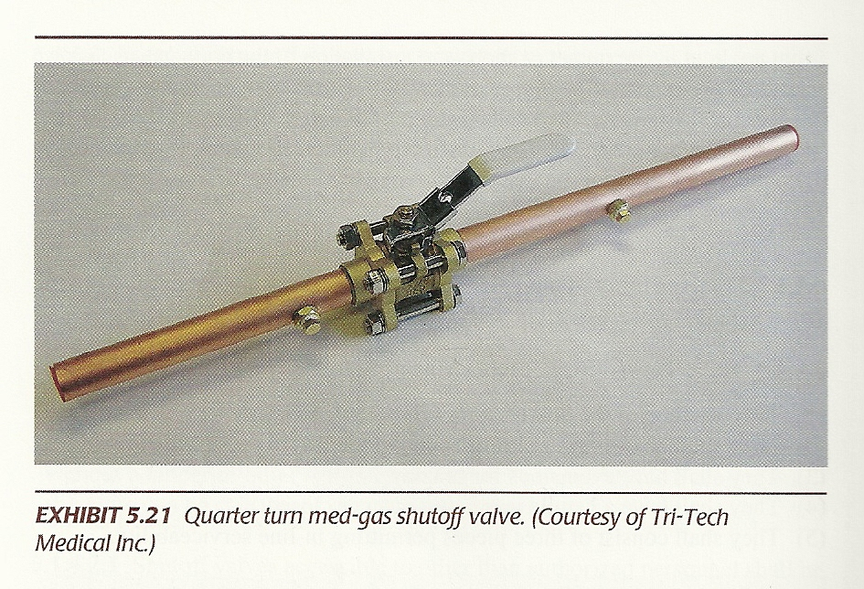
Correct Valve Type

Slide 29
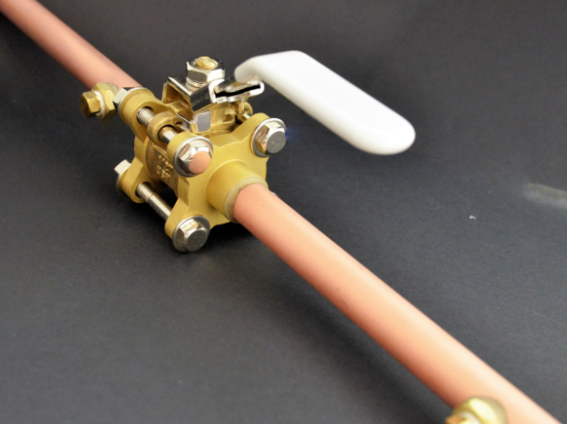
Medical Gas Valve

Slide 30
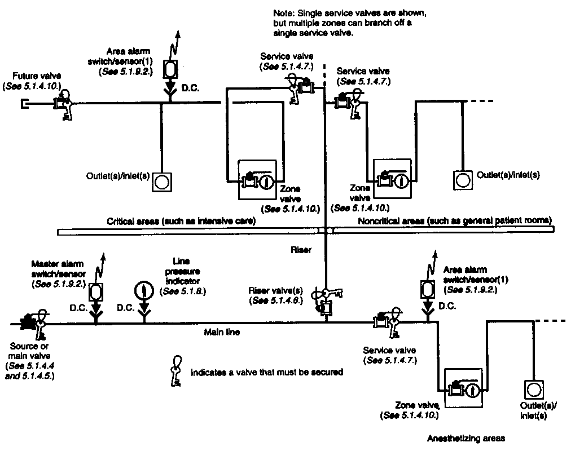
Main Line Valve

Slide 31
Riser Valve

Slide 32
Service Valves

Slide 33
5.1.4.5.2 Only one service valve shall be required for each branch off of a riser, regardless of how many zone valve boxes are installed on that lateral.
5.1.4.5.3 Service valves shall be placed in the branch piping prior to any zone valve box assembly on that branch.
5.1.4.6 Zone Valves.
5.1.4.6.1 All station outlets/inlets shall be supplied through a zone valve, which shall be placed as follows:
(1) It is installed so that a wall intervenes between the valve and the outlets/inlets that it controls.
(2)* It is readily operable from a standing position.
(3) It is installed where it is visible and accessible at all times.
(4) It is not installed where it can be hidden from plain view, such as behind normally open or normally closed doors.

Slide 34
(5) It is not installed in a room with the station outlets/inlets that it controls.
(6) It is not installed in rooms, areas, or closets that can be closed or locked.
5.1.4.6.2 A zone valve in each medical gas or vacuum line shall be provided for each Category 1 space and anesthetizing location for moderate sedation, deep sedation, or general anesthesia specific for the occupancy and shall be located as follows:
(1) They are installed immediately outside the area controlled.

Slide 35
(2) They are installed where they are visible and accessible at all times.
5.1.4.6.3 Piping on the patient side of zone valves shall be arranged to provide the following:
(1) Shutting off the supply of medical gas or vacuum to one zone will not affect the supply of medical gas or vacuum to another zone or the rest of the system.
(2) Service will only be to outlets/inlets located on that same story.
(3) All gas delivery columns, hose reels, ceiling tracks, control panels, pendants, booms, or other special installations are located on the patient side of the zone valve.
5.1.4.6.4 A pressure/vacuum indicator shall be provided on the station outlet/inlet side of each zone valve.

Slide 36
5.1.4.7 In-Line Shutoff Valves. Optional in-line valves shall be permitted to be installed to isolate or shut off piping for servicing of individual rooms or areas.
5.1.4.8 Valves for Future Connections.
5.1.4.8.1 Future connection valves shall be labeled as to gas content.
5.1.4.8.2 Downstream piping shall be closed with a brazed cap with tubing allowance for cutting and rebrazing.
5.1.4.9 In-Line Check Valves. New or replacement check valves shall be as follows:
(1) They shall be of brass or bronze construction.
(2) They shall have brazed extensions.
(3) They shall have in-line serviceability.
(4) They shall not have threaded connections.
(5) They shall have threaded purge points of 1∕8 in. NPT.
(6) They shall be sized to have a maximum velocity which does not exceed the manufacturer's recommendations.

Slide 37
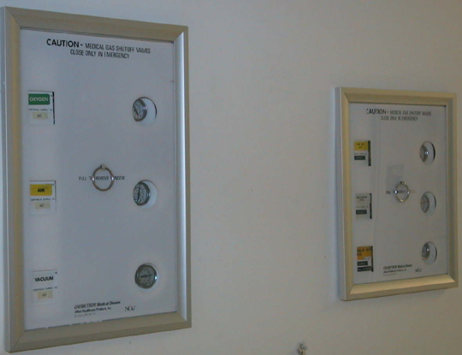
Zone Valve Boxes

Slide 38
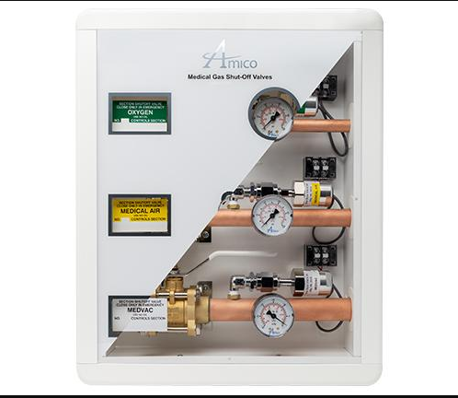
Zone Valve Box With Sensors

Slide 39
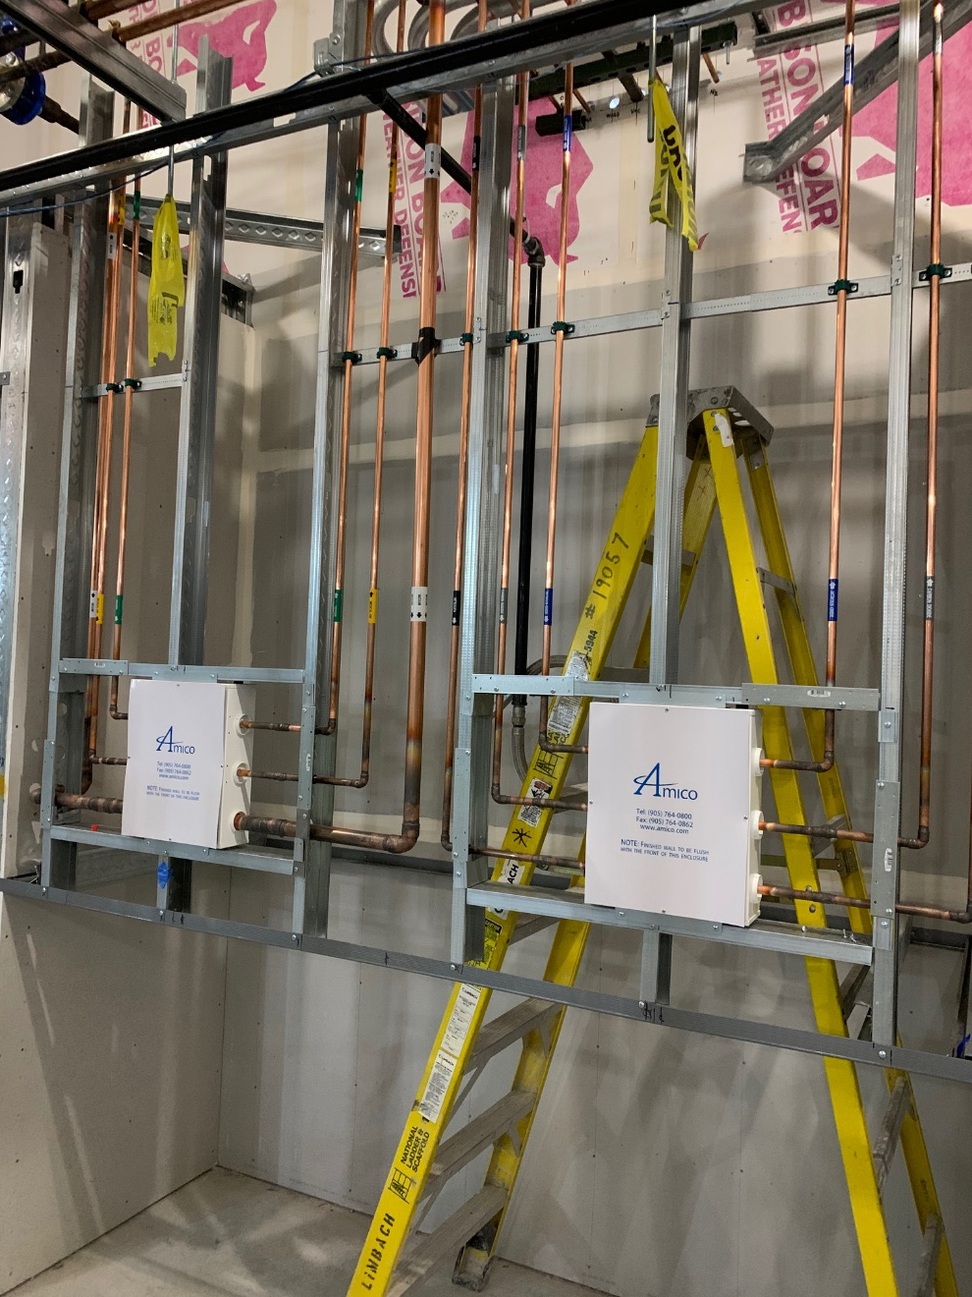
Zone Valve Box Piping

Slide 40
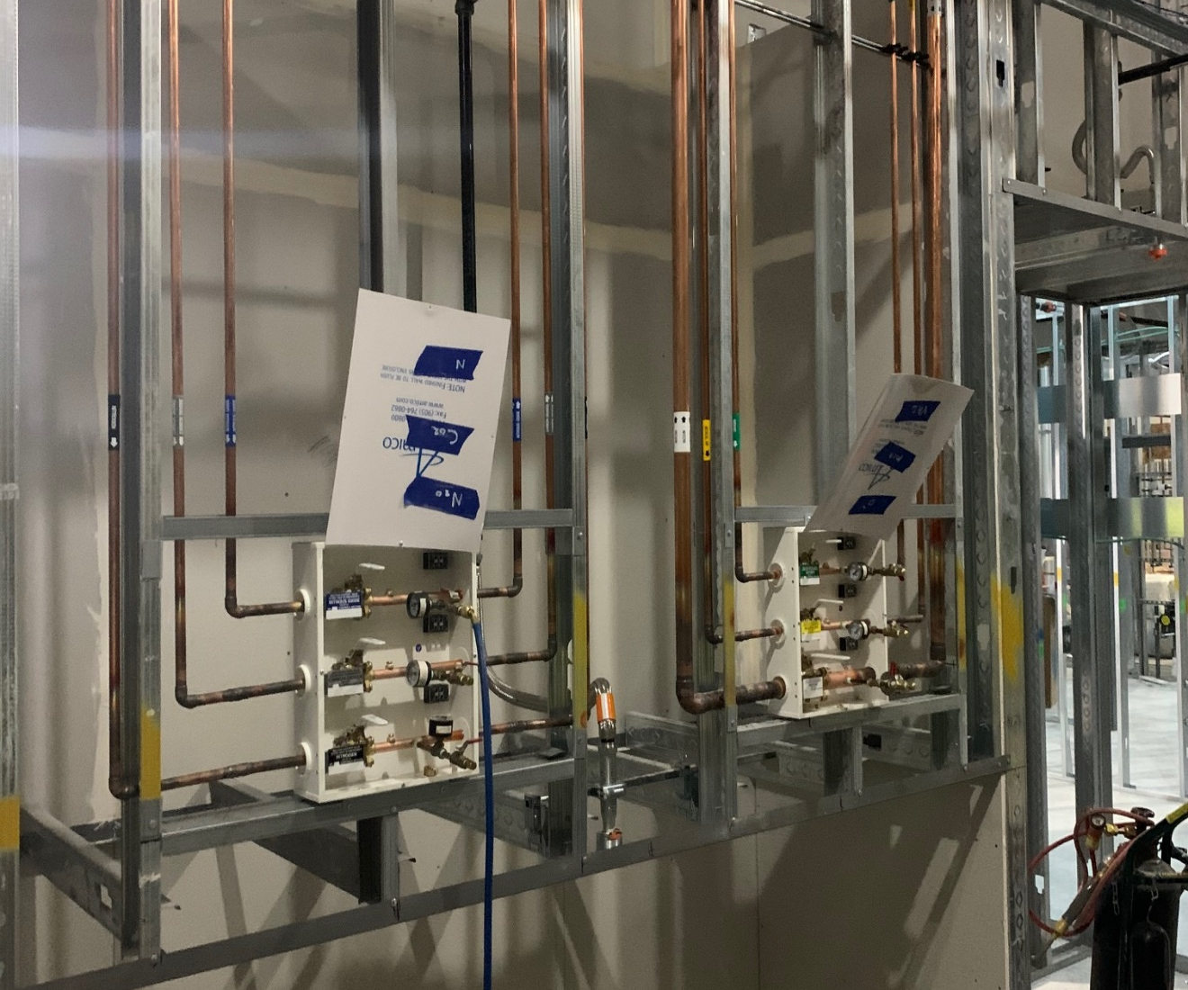
Zone Valve Box With Sensor Ports And Test / Purge

Slide 41
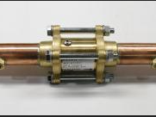
Medical Gas Check Valve

Slide 42
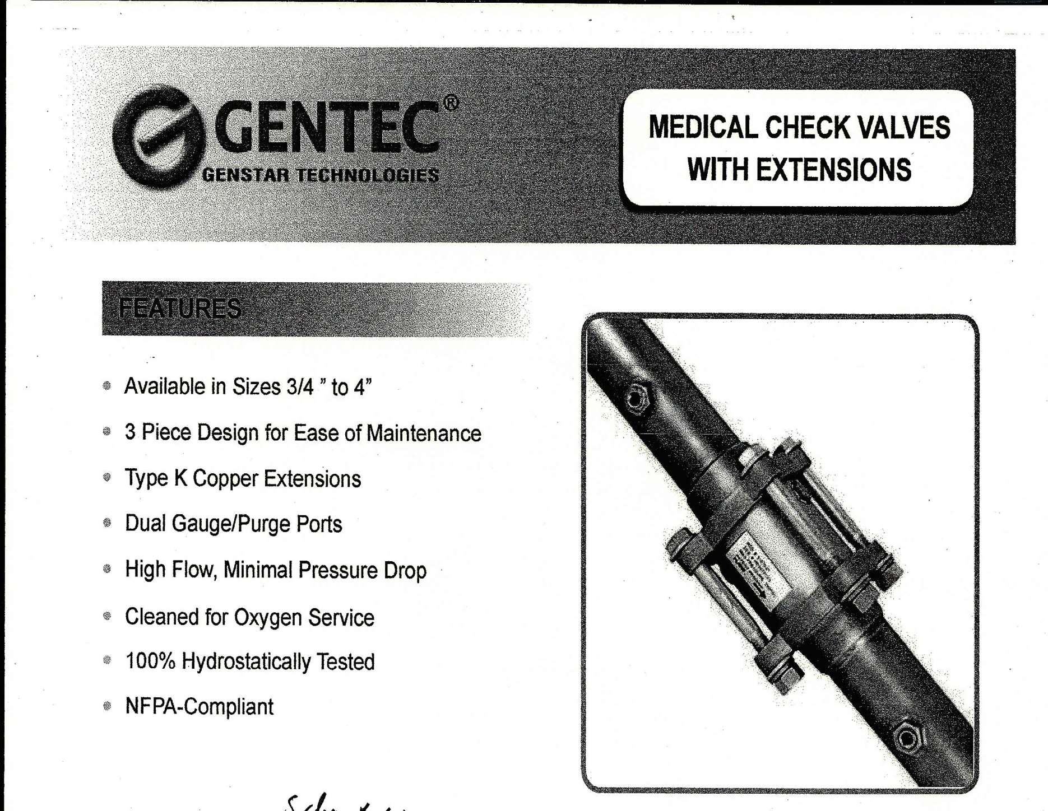
Cleaned for oxygen service
Construction for 300 psi

Slide 43
