Slide 1
2021 Code
5.1.12.1.4 Systems shall be deemed breached at the point of pipeline intrusion by physical separation or by system component removal, replacement, or addition.
5.1.12.1.5 Breached portions of the systems subject to inspection and testing shall be confined to only the specific altered zone and components in the immediate zone or area that is located upstream for vacuum systems and downstream for pressure gases at the point or area of intrusion.
5.1.12.1.9 All documentation pertaining to inspections and testing shall be maintained on-site within the facility.
5.1.12.1.10 Before piping systems are initially put into use, the facility authority shall be responsible for ascertaining that the gas/vacuum delivered at the outlet/inlet is that shown on the outlet/inlet label and that the proper connecting fittings are installed for the specific gas/vacuum service.

Slide 2
5.1.12.1.12 The removal of components within a source system for repair and reinstallation, or the replacement of components like for like, shall be treated as new work for the purposes of testing whenever such work involves cutting or brazing new piping, or both.
5.1.12.1.12.1 Where no piping is changed, functional testing shall be performed as follows:
(1) To verify the function of the replaced device
(2) To ensure no other equipment in the system has been adversely impacted
5.1.12.1.13 The rated accuracy of pressure and vacuum indicators used for testing shall be 1 percent (full scale) or better.

Slide 3
5.1.12.2.1.2 The test gas shall be oil-free, dry nitrogen NF.
5.1.12.2.2 Initial Piping Blowdown. Piping in medical gas and vacuum distribution systems shall be blown clear by means of oil-free, dry nitrogen NF after installation of the distribution piping but before installation of station outlet/inlet rough-in assemblies and other system components (e.g., pressure/vacuum alarm devices, pressure/vacuum indicators, pressure relief valves, manifolds, source equipment).
5.1.12.2.3 Initial Pressure Test.
5.1.12.2.3.2 Initial pressure tests shall be conducted as follows:
(1) After blowdown of the distribution piping
(2) After installation of station outlet/inlet rough-in assemblies
(3) Prior to the installation of components of the distribution piping system that would be damaged by the test pressure (e.g., pressure/vacuum alarm devices, pressure/vacuum indicators, line pressure relief valves)

Slide 4
5.1.12.2.3.4 The test pressure for pressure gases and vacuum systems shall be 1.5 times the system operating pressure but not less than a gauge pressure of 1035 kPa (150 psi).
5.1.12.2.3.5* The test pressure shall be maintained until each joint has been examined for leakage by means of a leak detectant that is safe for use with oxygen and does not contain ammonia.

Slide 5
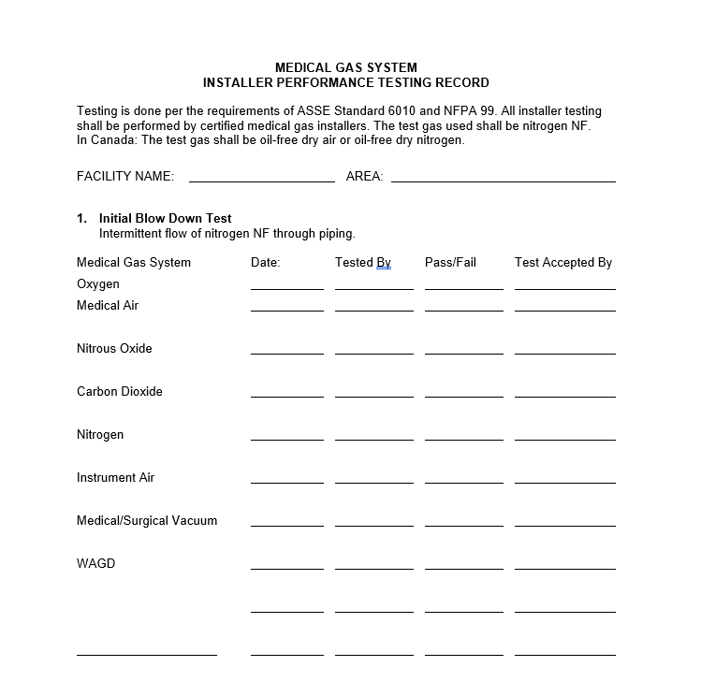

Slide 6
5.1.12.2.4 Initial Cross-Connection Test. It shall be determined that no cross-connections exist between the various medical gas and vacuum piping systems.
5.1.12.2.4.1 All piping systems shall be reduced to atmospheric pressure.
5.1.12.2.4.2 Sources of test gas shall be disconnected from all piping systems, except for the one system being tested.
5.1.12.2.4.3 The system under test shall be charged with oil-free, dry nitrogen NF to a gauge pressure of 345 kPa (50 psi).
5.1.12.2.4.4 After the installation of the individual faceplates with appropriate adapters matching outlet/inlet labels, each individual outlet/inlet in each installed medical gas and vacuum piping system shall be checked to determine that the test gas is being dispensed only from the piping system being tested.

Slide 7
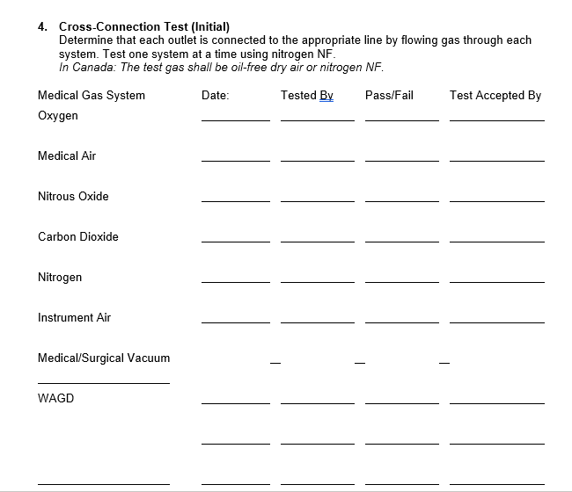

Slide 8
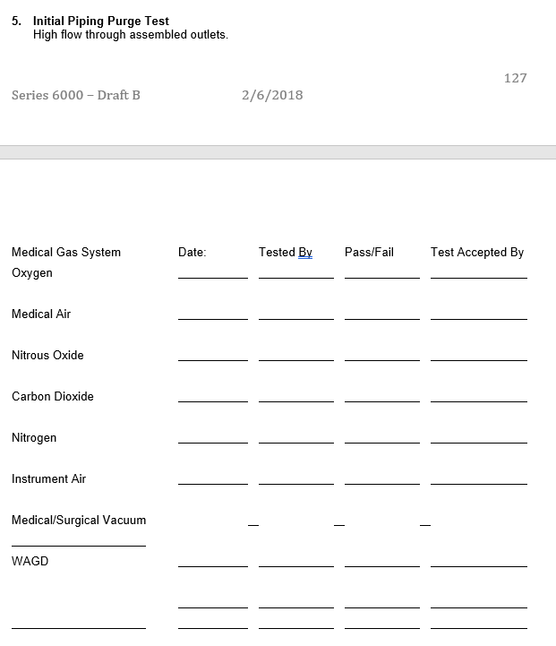

Slide 9
5.1.12.2.4.5 The cross-connection test referenced in 5.1.12.2.4 shall be repeated for each installed medical gas and vacuum piping system.
5.1.12.2.4.6 The proper labeling and identification of system outlets/inlets shall be confirmed during these tests.
5.1.12.2.5 Initial Piping Purge Test.
The outlets in each medical gas piping system shall be purged to remove any particulate matter from the distribution piping.
5.1.12.2.5.1 Using appropriate adapters, each outlet shall be purged with an intermittent high-volume flow of test gas until the purge produces no discoloration in a clean white cloth.
5.1.12.2.5.2 The purging required in 5.1.12.2.5.1 shall be started at the closest outlet/inlet to the zone valve and continue to the furthest outlet/inlet within the zone.
5.1.12.2.6 Standing Pressure Test for Positive Pressure Medical Gas Piping. After successful completion of the initial pressure tests under 5.1.12.2.3, medical gas distribution piping shall be subject to a standing pressure test.

Slide 10
5.1.12.2.6.2 The source valve shall be closed during this test.
5.1.12.2.6.3 The piping systems shall be subjected to a 24-hour standing pressure test using oil-free, dry nitrogen NF.
5.1.12.2.6.4 Test pressures shall be 20 percent above the normal system operating line pressure.
5.1.12.2.6.7 The 24-hour standing pressure test of the positive pressure system shall be witnessed by an ASSE 6020 inspector, an ASSE 6030 verifier, or the authority having jurisdiction or its designee. A form indicating that this test has been performed and witnessed shall be provided to the verifier at the start of the tests required in 5.1.12.4.
5.1.12.2.7.1 Tests shall be conducted after installation of all components of the vacuum system.

Slide 11
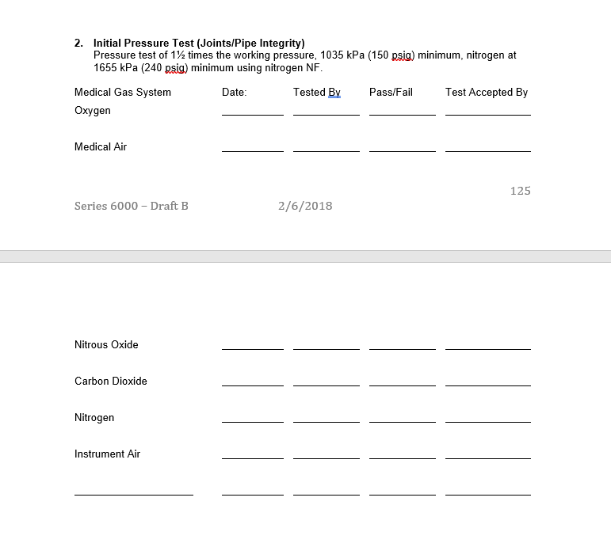

Slide 12
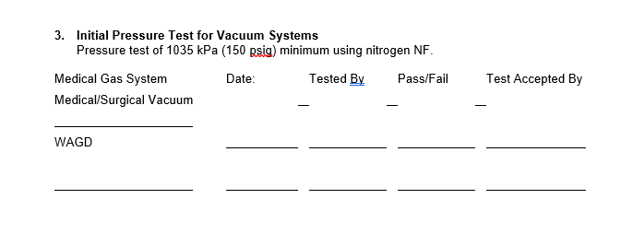

Slide 13
5.1.12.2.7.2 The piping systems shall be subjected to a 24-hour standing vacuum test.
5.1.12.2.7.3 Test pressure shall be between 300 mm (12 in.) HgV and full vacuum.
5.1.12.2.7.4 During the test, the source of test vacuum shall be disconnected from the piping system.
5.1.12.2.7.5* The leakage over the 24-hour test shall not exceed 0.5 percent of the starting pressure [e.g., 0.3 mm (0.125 in.) HgV starting at 635 mm (25 in.) HgV] except that attributed to specific changes in ambient temperature.
5.1.12.2.7.6 The 24-hour standing pressure test of the vacuum system shall be witnessed by the authority having jurisdiction or its designee. A form indicating that this test has been performed and witnessed shall be provided to the verifier at the start of the tests required in 5.1.12.4.

Slide 14
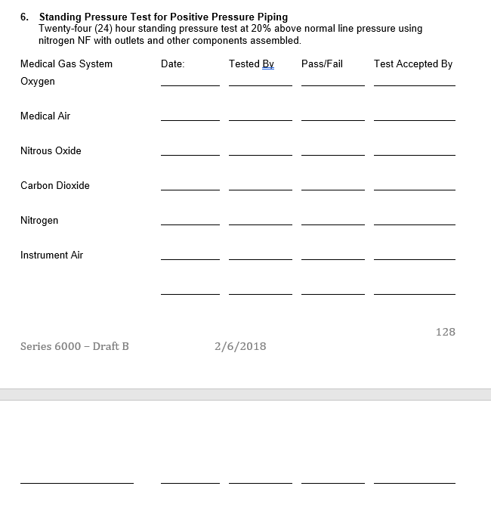

Slide 15
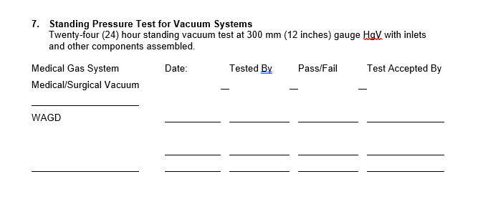

Slide 16
5.1.12.3.1.1 System inspections shall be performed prior to concealing piping distribution systems in walls, ceilings, chases, trenches, underground, or otherwise hidden from view.
5.1.12.3.1.2 The test gas shall be nitrogen NF.
5.1.12.3.1.3 Inspections shall be conducted by a party technically competent and experienced in the field of medical gas and vacuum pipeline inspections and testing and meeting the requirements of ASSE 6020, Professional Qualifications Standard for Medical Gas Systems Inspectors, or ASSE 6030, Professional Qualifications Standard for Medical Gas Systems Verifiers.
5.1.12.3.1.4 Inspections shall be performed by a party other than the installing contractor.

Slide 17
5.1.12.3.1.5 Where systems have not been installed by in house personnel, inspections shall be permitted by personnel of the organization who meet the requirements of 5.1.12.3.1.3.
5.1.12.3.2 Inspections.
5.1.12.3.2.1 The initial pressure tests performed by the installing contractor shall be witnessed by an ASSE 6020 inspector, an ASSE 6030 verifier, or the authority having jurisdiction or its designee. A form indicating that this test has been performed and witnessed shall be provided to the verifier at the start of the tests required in 5.1.12.4.
5.1.12.3.2.2 The presence and correctness of labeling and valve tagging required by this code for all concealed components and piping distribution systems shall be inspected.

Slide 18
5.1.12.4.1.1 Verification tests shall be performed only after all tests required in 5.1.12.2, Installer Performed Tests, have been completed.
5.1.12.4.1.2 The test gas shall be oil-free, dry nitrogen NF or the system gas where permitted.
5.1.12.4.1.3 Testing shall be conducted by a party technically competent and experienced in the field of medical gas and vacuum pipeline testing and meeting the requirements of ASSE 6030, Professional Qualifications Standard for Medical Gas Systems Verifiers, except as required by 5.1.12.4.1.4.
5.1.12.4.1.4 Testing of the cryogenic fluid central supply system shall be conducted by a party technically competent and experienced in the field of cryogenic fluid systems and meeting the requirements of ASSE 6035, Professional Qualifications Standard for Bulk Medical Gas Systems Verifiers, in accordance with the mandatory requirements in CGA M-1, Standard for Medical Gas Supply Systems at Health Care Facilities.

Slide 19
5.1.12.4.1.5 Testing shall be performed by a party other than the installing contractor.
5.1.12.4.1.6 When systems have not been installed by in-house personnel, testing shall be permitted by personnel of that organization who meet the requirements of 5.1.12.4.1.3.
5.1.12.4.2* Standing Pressure Test. Piping systems shall be subjected to a 10-minute standing pressure test at operating line pressure using the following procedure:
(1) After the system is filled with nitrogen or source gas, the source valve and all zone valves shall be closed.
(2) The piping system shall show no decrease in pressure after 10 minutes.
5.1.12.4.3 Cross-Connection Test. After the closing of walls and completion of the requirements of 5.1.12.2, it shall be determined that no cross-connection of piping systems exists by either of the methods detailed in 5.1.12.4.3.1 or 5.1.12.4.3.2.

Slide 20
5.1.12.4.6 Piping Purge Test. In order to remove any traces of particulate matter deposited in the pipelines as a result of construction, a heavy, intermittent purging of the pipeline shall be done.
5.1.12.4.6.1 The appropriate adapter shall be obtained from the facility or manufacturer, and high purge rates of at least 225 Nl/min (8 SCFM) shall be put on each outlet.
5.1.12.4.6.4* No pronounced or objectionable odor shall be discernible from any positive pressure outlet.
5.1.12.4.7 Piping Particulate Test. For each positive pressure gas system, the cleanliness of the piping system shall be verified.
5.1.12.4.7.1 A minimum of 1000 L (35 ft³) of gas shall be filtered through a clean, white 0.45 micron filter at a minimum flow rate of 100 Nl/min (3.5 SCFM).
5.1.12.4.7.2 Twenty-five percent of the zones shall be tested at the outlet most remote from the source.

Slide 21
5.1.12.4.7.4 If any outlet fails this test, the most remote outlet in every zone shall be tested.
5.1.12.4.8.2 The outlet most remote from the source shall be tested for total nonmethane hydrocarbons and halogenated hydrocarbons and compared to the source gas.
5.1.12.4.8.4 The difference between the two tests shall in no case exceed 5 ppm of total non-methane hydrocarbons.
5.1.12.4.8.5 The difference between the two tests shall in no case exceed 5 ppm halogenated hydrocarbons.
5.1.12.4.8.6 The moisture concentration of the outlet test shall not exceed 500 ppm or an equivalent pressure dew point of -12°C (10°F) at a gauge pressure of 345 kPa (50 psi).

Slide 22
5.1.12.4.9.2 Each joint in the final connection between the new work and the existing system shall be leak-tested with the gas of system designation at the normal operating pressure by means of a leak detectant that is safe for use with oxygen and does not contain ammonia.
5.1.12.4.9.3 Vacuum joints shall be tested using an ultrasonic leak detector or other means that will allow detection of leaks in an active vacuum system.
5.1.12.4.10.2 All gas outlets with a gauge pressure of 345 kPa (50 psi), including, but not limited to, oxygen, nitrous oxide, medical air, and carbon dioxide, shall deliver 100 SLPM (3.5 SCFM) with a pressure drop of not more than 35 kPa (5 psi) and static pressure of 345 kPa to 380 kPa (50 psi to 55 psi)

Slide 23
5.1.12.4.10.4 Medical–surgical vacuum inlets shall draw 85 Nl/min (3 SCFM) without reducing the vacuum pressure below 300 mm (12 in.) gauge HgV at any adjacent station inlet.
(F) The aggregate run time on the compressors shall not be used to determine the elapse time.
(G) Loading shall be simulated by continuously venting air at approximately 25 percent of the rated system capacity.
(H) A demand of approximately 25 percent of the rated compressor capacity shall be created to cause the compressors to cycle on and off continuously and the dryers to operate for the 12-hour period.
5.1.12.4.14.4 Oxygen Central Supply System Using Concentrators.
The oxygen central supply system using concentrators shall be tested according to the following:
(1) The oxygen central supply system shall be tested for purity of the oxygen.
(2) Tests of the alarms after calibration and setup per the manufacturer’s instructions shall be conducted as well as tests of the operational controls

Slide 24
(3) Each concentrator supply system shall be operated with the supply system’s isolating valve closed and the unit venting at a flow of 25 percent or more of nameplate capacity for an elapsed time of at least 12 hours prior to the tests in 5.1.12.4.14.4(4).
(4) The oxygen quality from each concentrator supply system shall be validated as follows:
(a) The operation of all control sensors/switches and the oxygen monitor shall be checked for proper operation and function.
(b) The quality of the oxygen shall be confirmed to meet the USP monograph appropriate for the technology in use.

Slide 25
(c) The accuracy of the oxygen monitor shall be validated against oxygen of known concentration, and the monitor calibrated in accordance with the manufacturer’s specifications.
(5) The central supply system shall be tested for correct operation of the cascade (i.e., primary — secondary — reserve). It shall be permitted to test source rotation for systems so constructed.
(6) The operation of all alarms [see 5.1.9.2.4(14) and 5.1.9.5.4(13)] shall be tested.
(7) The accuracy of the central system oxygen monitor shall be calibrated in accordance with the manufacturer’s specifications.

Slide 26
(8) Tests in 5.1.12.4.14.4(3) to 5.1.12.4.14.4(5) shall be performed when any concentrator supply system has been opened to atmosphere (e.g., during service or replacement).
5.1.13 Category 1 Medical Support Gases.
5.1.13.1 * Applicability.
5.1.13.1.1 Medical support gases consist of nitrogen NF or instrument air and are used primarily for powering equipment used in patient care procedures. Medical support gas applications require delivery at pressures, cleanliness, or purities specific to their intended function(s) (e.g., to operate medical–surgical tools). Medical support gases shall be permitted to be piped into areas intended for any medical support purpose and, if appropriate to the procedures, to be piped into laboratories.

Slide 27
5.1.13.3.2 Design and Construction.
5.1.13.3.2.1 Locations for medical support gas central supply systems, excluding cryogenic fluid central supply systems, and for the storage of positive-pressure gases shall meet the requirements of 5.1.3.3.2.
5.1.13.3.2.2 Design and construction of locations for cryogenic fluid central supply systems shall meet the requirements of 5.1.3.10.
5.1.13.3.3 Ventilation. Ventilation for medical support gas central supply systems shall meet the requirements of 5.1.3.3.3.
5.1.13.3.4 Storage. Storage for medical support gas central supply systems shall meet the requirements of 5.1.3.3.4.

Slide 28
5.1.13.3.5 Control Equipment. Control equipment for medical support gas central supply systems shall meet the requirements of 5.1.3.4.
5.1.13.3.6 Nitrogen NF Central Supply Systems. Nitrogen NF central supply systems shall be permitted to consist of the following:
(1) Manifolds for gas cylinders in accordance with 5.1.3.5.11
(2) Manifolds for cryogenic liquid containers in accordance with 5.1.3.5.12
(3) Cryogenic fluid central supply systems in accordance with 5.1.3.10
5.1.13.3.6.1 General.
(A) Nitrogen NF central supply systems shall be obtained from a supplier or manufacturer familiar with their proper construction and use.
(B) Nitrogen NF central supply systems shall be installed in accordance with the manufacturer’s instructions.

Slide 29
5.1.13.3.6.2 Medical Support Gases. Nitrogen NF central supply systems for medical support gases shall not be piped to, or used for, any purpose except medical support application.
5.1.13.3.6.3 Materials. Materials used in nitrogen NF central supply systems shall meet the requirements of 5.1.3.5.4.
5.1.13.3.6.4 Controls for Line Pressure. Controls for line pressure used for nitrogen central supply systems shall meet the criteria in 5.1.3.5.5.
5.1.13.3.6.5 Relief Valves. Relief Valves used for nitrogen central supply systems shall meet the criteria in 5.1.3.5.6.
5.1.13.3.6.6 Multiple Pressures. Where a single nitrogen central supply system supplies separate piped distribution networks, operating at different pressures, each piped distribution network shall meet the criteria in 5.1.3.5.7.

Slide 30
5.1.13.3.6.7 Local Signals.
(A) The following nitrogen NF central supply systems shall have local signals located at the source equipment:
(1) Manifolds for gas cylinders without reserve supply (see 5.1.3.5.11)
(2) Manifolds for cryogenic liquid containers (see 5.1.3.5.12)
(3) Cryogenic fluid central supply systems (see 5.1.3.10)
(B) Local signals shall meet the requirements of 5.1.3.5.8.2.
5.1.13.3.6.8 Headers.
In nitrogen NF central supply systems using cylinders containing either gas or liquid, each header shall meet the requirements of 5.1.3.5.9.

Slide 31
5.1.13.3.6.9 Nitrogen NF Manifolds for Gas Cylinders.
Manifolds for gas cylinders shall be in accordance with 5.1.3.3.1 and shall meet the requirements of 5.1.3.5.11.
5.1.13.3.6.10 Nitrogen NF Manifolds for Cryogenic Liquid Containers.
Manifolds for cryogenic liquid containers shall be in accordance with 5.1.3.3.1 and shall meet the requirements of 5.1.3.5.1.
5.1.13.3.6.11 Nitrogen NF Cryogenic Fluid Central Supply Systems.
Cryogenic fluid central supply systems shall be in accordance with 5.1.3.3.1 and shall meet the requirements of 5.1.3.10.
5.1.13.3.7 * Instrument Air Supply Systems.
5.1.13.3.7.1 Quality of Instrument Air.
The quality of instrument air shall be as follows:

Slide 32
(1) Compliant with ANSI/ISA S-7.0.01, Quality Standard for Instrument Air
(2) Filtered to 0.01 micron
(3) Free of liquids (e.g., water, hydrocarbons, solvents)
(4) Free of hydrocarbon vapors
(5) Dry to a dew point of −40°C (−40°F)
5.1.13.3.7.3 Instrument air sources shall provide air with the following characteristics:
(1) A gauge pressure adequate for the intended line pressure and pressure controls (see Table 5.1.11)
(2) The quality of instrument air, as described in 5.1.13.3.7.1

Slide 33
5.1.13.3.7.4 Instrument air sources shall be of either of the following formats:
(1) At least two compressors
(2) One compressor and a standby header complying with 5.1.3.5.9
5.1.13.3.7.6 Instrument Air Standby Headers. Where instrument air systems are provided with a standby header, the header shall meet the following requirements:
(1) It shall comply with 5.1.3.5.9, except that the number of attached cylinders shall be sufficient for 1 hour of normal operation.
(2) It shall use connectors as for medical air in the mandatory requirements of CGA V-1, Standard for Compressed Gas Cylinder Valve Outlet and Inlet Connections (ANSI B57.1).
(3) It shall enter the system upstream of the final line filters.

Slide 34
5.1.13.3.7.7 * Intake Air. Intake air for instrument air compressors shall be permitted to be drawn from outside, from ducted air, or from the equipment location.
5.1.13.3.7.8 Instrument Air Filters. Instrument air sources shall be provided with filtration sized for 100 percent of the system peak calculated demand at design conditions and with the following elements and characteristics:
(1) Activated carbon filters located upstream (source side) of the final line filters
(2) Line filters located upstream (source side) of the final line regulators and downstream of the carbon filters rated for a minimum of 98 percent efficiency at 0.01 micron
(3) Equipped with a continuous visual indicator showing the status of the line filter element life
(4) Constructed of materials deemed suitable by the manufacturer

Slide 35
5.1.13.3.7.10 Instrument Air Piping Arrangement and Redundancies. Instrument air sources shall comply with 5.1.3.6.3.9, except for the following:
(1) Systems employing a standby header shall be permitted to have simplex aftercoolers and dryers.
(2) Systems employing a standby header shall not require a three-valve receiver bypass.
(3) Standby headers, where provided, shall be isolated from the compressor by a check valve to prevent backflow through the compressor.
5.1.13.3.7.11 Instrument Air Monitoring and Alarms.
(A) Instrument air sources shall include the following alarms:
(1) A manual-reset local alarm that indicates when the capacity of the instrument air central supply system not in use is less than the equivalent capacity of one compressor

Slide 36
(2) Local alarm and alarms at all master alarm panels that activate when the dew point at system pressure exceeds −30°C (−22°F), indicating a high dew point
(B) For sources with standby headers, the following additional conditions shall activate a local alarm at the compressor site, a local signal at the header location, and alarms at all master alarm panels:
(1) Alarm that activates when or just before the reserve begins to supply the system, indicating reserve in use
(2) Alarm that activates when or just before the reserve falls below one average hour’s supply, indicating reserve is low

Slide 37
5.1.13.8 Line Pressure Control. Instrument air systems shall be provided with means to control line pressure at the source with at least the following characteristics:
(1) Able to maintain stable pressures within the limits of Table 5.1.11
(2) Able to flow 100 percent of the peak calculated demand
(3) Redundant, such that each component of the control mechanism can be isolated for service or replacement while maintaining normal operation
(4) Protected against overpressure (see 5.1.3.5.6)
(5) Be constructed of materials deemed suitable for the service by the manufacturer

Slide 38
5.1.14 * Category 1 Operation and Management.
5.1.14.1 Responsible Facility Authority.
5.1.14.1.1 General. Each health care facility shall designate one or more individuals to be the Responsible Facility Authority with respect to the facility's medical gas and vacuum systems.
5.1.14.1.2 Responsibilities.
5.1.14.1.2.1 The Responsible Facility Authority shall have primary responsibility for implementation of the piped medical gas and vacuum system requirements of this code for the health care facility, including all medical gas, support gas, medical vacuum, and WAGD systems.

Slide 39
5.1.14.1.2.2 The Responsible Facility Authority shall be responsible for the following:
(1) Advising on Section 1.3 and the risk assessment in accordance with Section 4.2, as these apply to piped medical gas and vacuum systems, and the interpretations of Sections 5.1 through 5.3, as they apply to the facility
(2) Writing and upkeep of the portions of the health care facility's emergency plan that might affect or be affected by piped medical gas and vacuum quality, quantity, and continuity of supply
(3) Ensuring that the health care facility's emergency plan specifically addresses unusual or exceptional requirements necessary for patient and staff safety arising from elements of design or construction of the building

Slide 40
(4) Developing and enforcing permit-to-work rules pertaining to the piped medical gas and vacuum systems and equipment to maintain patient, staff, and visitor safety during repair, modification, or construction of those systems
(5) Evaluation and acceptance of the test reports required in accordance with 5.1.12
(6) Maintenance of the facility's records on piped medical gas and vacuum system installations and operations
5.1.14.1.3 Qualifications.
5.1.14.1.3.1 The person(s) designated as the Responsible Facility Authority shall be qualified to interpret, implement and advise on this Code.

Slide 41
5.1.14.1.3.2 Appropriate qualification shall be demonstrated by any of the following:
(1) Completion of an educational program acceptable to the health care facility’s governing body and substantially equivalent or superior to either 5.1.14.1.3.2(2) or 5.1.14.1.3.2(3)
(2) Credentialing to the requirements of ASSE 6010, Profes­sional Qualifications Standard for Medical Gas Systems Installers, and technical competence on the specific equipment and design of that facility
(3) Credentialing to the requirements of ASSE 6020, Profes­sional Qualifications Standard for Medical Gas Systems Inspectors, and technical competence on the specific equipment and design of that facility
(4) Credentialing to the requirements of ASSE 6030, Profes­sional Qualifications Standard for Medical Gas Systems Verifiers, and technical competence on the specific equipment and design of that facility
(5) Credentialing to the requirements of ASSE 6040, Profes­sional Qualifications Standard for Medical Gas Maintenance Personnel, and technical competence on the specific equipment and design of that facility

Slide 42
5.1.14.2 Permit-to-Work System.
5.1.14.2.1 * The Responsible Facility Authority of the health care facility shall develop, maintain, and manage a permit-to-work system ensuring uninterrupted quality, quantity, and continuity of supply during all piped medical gas and vacuum system maintenance, repair, or construction work.
5.1.14.2.2 The Responsible Facility Authority’s plan shall include processes to assure at least the following:
(1) The affected medical staff and facility administration is appropriately in communication prior to any work on piped medical gas and vacuum systems

Slide 43
(2) Alternative supply or adjustments in patient care arrangements are in place prior to system interruption, including monitoring, as appropriate, of the work being performed and the alternate arrangements in use
(3) All work on piped medical gas and vacuum systems is performed by competent individuals holding appropriate qualifications for the work
(4)* Procedures for shutdown and restoration of medical gases are described, communicated, and observed by all persons working on or with the systems
(5) Safety procedures are in place and are observed for all persons involved in working on the systems
(6) This code is observed in the execution of maintenance, repair, or construction procedures
(7) The affected portions of the systems are correctly tested in accordance with 5.1.12 and 5.1.13 and demonstrated to be acceptable for patient use

Slide 44
5.1.14.3.5 * When clinical spaces are converted to nonclinical spaces, medical gas inlets and outlets that are not accessible for maintenance and testing shall be either removed or decommissioned.
5.1.14.4 Maintenance of Medical Gas, Vacuum, WAGD, and Medical Support Gas Systems.
5.1.14.4.1 * General. Health care facilities with installed medical gas, vacuum, WAGD, or medical support gas systems, or combinations thereof, shall develop and document periodic maintenance programs for these systems and their subcomponents as appropriate to the equipment installed.
5.1.14.4.2.2 * Inspection Schedules. Scheduled inspections for equipment and procedures shall be established through the risk assessment of the facility and developed with consideration of the original equipment manufacturer recommendations and other recommendations as required by the authority having jurisdiction.

Slide 45
5.1.14.4.2.5 Qualifications.
(A) Persons maintaining these systems shall be qualified to perform these operations.
(B) Appropriate qualification shall be demonstrated by any of the following:
(1) A documented training program acceptable to the health care facility by which such persons are employed or contracted to work with specific equipment as installed in that facility
(2) Credentialing to the requirements of ASSE 6040, Profes­sional Qualifications Standard for Medical Gas Maintenance Personnel, and technically competent on the specific equipment as installed in that facility.
(3) Credentialing to the requirements of ASSE 6030, Profes­sional Qualifications Standard for Medical Gas Systems Verifiers, and technically competent on the specific equipment as installed in that facility.

Slide 46
5.1.14.4.3 * Inspection and Testing Operations.
5.1.14.4.3.1 Manufactured Assemblies Employing Flexible Connection(s) Between the User Terminal and the Piping System.
(A) Nonstationary booms and articulating assemblies, other than head walls utilizing flexible connectors, shall be tested for leaks, per manufacturer’s recommendations, every 18 months or at a duration as determined by a risk assessment.
5.1.14.5.2 Labels for shutoff valves shall be in accordance with 5.1.11.2 and updated when modifications are made changing the areas served.
5.1.14.7.4 Central supply systems for nonflammable medical gases shall conform to the following:
(1) They shall be inspected annually.

Slide 47
(2) They shall be maintained by a qualified representative of the equipment owner.
(3) A record of the annual inspection shall be available for review by the authority having jurisdiction.
5.1.14.7.8 Audible and visual alarm indicators shall meet the following requirements:
(1) They shall be periodically tested to determine that they are functioning properly.
(2) Records of the test shall be maintained until the next test is performed.
5.1.14.7.10 Where oxygen central supply systems using concentrators are used and one or more of the three sources is a cylinder header, the facility shall establish procedures to ensure the facility is always provided with one average day’s supply of oxygen meeting the supply system product purity specification in reserve, as follows:

Slide 48
(1) The facility shall establish a minimum cylinder pressure that will permit one average day’s supply. That value will be included as part of the standard operating procedure for the oxygen supply system.
(2) The cylinders shall be inspected daily and any loss of pressure noted.
(3) When the cylinders are found to have lost pressure due to use or leakage and thus are below the pre-established pressure, the cylinders shall be exchanged.
5.1.14.7.11 * Access to valves and alarms shall be made part of the standard operating procedures for the facility and shall include the following:
(1) No items are to be placed in front of or affixed to any alarm panel that would restrict the view or diminish the sound of the alarm.

Slide 49
(2) Valves in secured areas are to be specified as follows:
(a)* The valve is visible from the intended operator's position.
(b) The valve is operable with no more than ordinary aids, such as a ladder.
(c) If the valve is provided with security hardware, such hardware is visible and readily removeable when needed.

Slide 50
5.2.1.2 Category 2 piped gas or piped vacuum system requirements shall be permitted when all of the following criteria are met:
(1) Only moderate sedation; minimal sedation, as defined in 3.3.65.3 and 3.3.65.4; or no sedation is performed. Deep sedation and general anesthesia shall not be permitted.
5.2.3.6 Oxygen supply systems using concentrators shall be permitted to consist of two sources, one of which shall be a cylinder header with sufficient cylinder connections for one average day’s supply.
5.2.3.7 Category 2 Medical–Surgical Vacuum. Category 2 systems shall comply with 5.1.3.7, except as follows:
(1) Medical–surgical vacuum systems shall be permitted to be simplex.

Slide 51
5.2.3.8 Category 2 WAGD. Category 2 systems shall comply with 5.1.3.8, except as follows:
Medical WAGD pumps shall be permitted to be simplex.
5.2.9 Warning Systems (Category 2). Warning systems associated with Category 2 systems shall provide the master, area, and local alarm functions of a Category 1 system as required in 5.1.9, except as follows:
(1) Warning systems shall be permitted to be a single alarm panel.
(2) The alarm panel shall be located in an area of continuous surveillance while the facility is in operation.
(3) Pressure and vacuum switches/sensors shall be mounted at the source equipment with a pressure indicator at the master alarm panel.

Slide 52
5.3.1.2 Category 3 piped gas and vacuum systems shall be permitted when all of the following criteria are met:
(1) Only moderate sedation; minimal sedation, as defined in 3.3.65.3 and 3.3.65.4; or no sedation is performed. Deep sedation and general anesthesia are not performed.
5.3.3.6.1 Medical Air Supply Systems. Category 3 systems shall comply with 5.1.3.5 and 5.1.3.6, except as follows:
(1) Medical air compressors, dryers, aftercoolers, filters, and regulators shall be permitted to be simplex.
5.3.3.7 Medical–Surgical Vacuum. Category 3 systems shall comply with 5.1.3.7, except as follows:
(1) Medical–surgical vacuum systems shall be permitted to be simplex.

Slide 53
5.3.3.8 WAGD. Category 3 systems shall comply with 5.1.3.8, except as follows:
Medical WAGD pumps shall be permitted to be simplex.
5.3.9 Warning Systems. Warning systems associated with Category 3 systems shall provide the master, area, and local alarm functions of a Category 1 system as required in 5.1.9, except as follows:
(1) Warning systems shall be permitted to be a single alarm panel.
(2) The alarm panel shall be located in an area of continuous surveillance while the facility is in operation.
(3) Pressure and vacuum switches/sensors shall be mounted at the source equipment with a pressure indicator at the master alarm panel.

