Slide 1
2021 Code
5.1.9* Category 1 Warning Systems.
5.1.9.1 General. All master, area, and local alarm systems used for medical gas and vacuum systems shall include the following:
(1) Separate visual indicators for each condition monitored, except as permitted in 5.1.9.5.2 for local alarms that are displayed on master alarm panels
(3) Cancelable audible indication of each alarm condition that produces a sound with a minimum level of 80 dBA at 0.92 m (3 ft)
(4) Means to indicate a lamp or LED failure and audible failure
(5) Visual and audible indication that the communication with an alarm-initiating device is disconnected

Slide 2
(8) Reinitiating of the audible signal if another alarm condition occurs while the audible alarm is silenced
(11) Where used for communications, wiring from switches or sensors that is supervised or protected as required by 517.30(C)(3) of NFPA 70 for life safety and critical branches circuits in which protection is any of the following types:
(a) Conduit
(b) Free air
(c) Wire
(d) Cable tray
(e) Raceways
(12) Communication devices that do not use electrical wiring for signal transmission and are supervised such that failure of communication initiates an alarm.

Slide 3
(14) Provisions for automatic restart after a power loss of 10 seconds (e.g., during generator start-up) without giving false signals or requiring manual reset
(15) Alarm switches/sensors installed so as to be removable and accessible for service and testing.
5.1.9.2* Master Alarms. A master alarm system shall be provided to monitor the operation and condition of the source of supply, the reserve source (if any), and the pressure in the main lines of each medical gas and vacuum piping system.
5.1.9.2.1 The master alarm system shall consist of two or more alarm panels located in at least two separate locations, as follows:
(1) One master alarm panel shall be located in the office or work space of the on-site individual responsible for the maintenance of the medical gas and vacuum piping systems.

Slide 4
(2) In order to ensure continuous surveillance of the medical gas and vacuum systems while the facility is in operation, the second master alarm panel shall be located in an area of continuous observation (e.g., the telephone switchboard, security office, or other continuously staffed location).
5.1.9.2.2 A centralized computer system shall be permitted to be substituted for one of the master alarms required in
5.1.9.2.1 if the computer system complies with 5.1.9.3.
5.1.9.2.3 The master alarm panels required in 5.1.9.2.1 shall communicate directly to the alarm-initiating devices that they monitor.
5.1.9.2.3.1 If communication is achieved by wires, the following shall apply:

Slide 5
(A) Each of the two mandatory alarms shall be wired independently to the initiating device(s) for each signal.
(B) The wiring between each mandatory alarm(s) and the initiating device(s) shall not utilize common conductors that, if interrupted, would disable more than one signal.
(C) Each set of wires (in whatever number as required by the alarm) shall run to the initiating device(s) without interruption other than in-line splices necessary to complete the necessary length of wire.
(D) Where initiating devices are remote from the building and the wiring is to run underground in compliance with NFPA 70, the following exceptions shall be permitted to be used:

Slide 6
(1) Wiring from the initiating device and through the underground section shall be permitted to be run to a junction box located where the wiring first enters the building.
(2) A single set of wires complying with 5.1.9.2.3.1(B) and 5.1.9.2.3.1(C) for each signal shall be permitted to connect the initiating device and the junction box.
5.1.9.2.3.2 If communication is achieved by means other than wires, the following shall apply:
(A) Each of the mandatory alarms shall communicate independently to the initiating device(s) for each signal.
(B) The means of communication between each mandatory alarm(s) and the initiating device(s) shall not utilize a common communication device that, if interrupted, would disable the signal from another initiating device.

Slide 7
5.1.9.2.3.3 A single initiating device shall be permitted to actuate multiple master alarms.
5.1.9.2.3.6 Master alarm signals shall not be relayed from one master alarm panel to another.
5.1.9.2.3.8 Multiple master alarms shall be permitted to monitor a single initiating device.
5.1.9.2.4 Master alarm panels for medical gas and vacuum systems shall each include the following signals:
(1) Alarm indication when, or just before, changeover occurs in a medical gas system that is supplied by a manifold or other alternating-type bulk system that has as a part of its normal operation a changeover from one portion of the operating supply to another
(2) Alarm indication for a bulk cryogenic liquid system when the main supply reaches one average day’s supply, indicating low contents

Slide 8
(3) Alarm indication when, or just before, the changeover to the reserve supply occurs in a medical gas system that consists of one or more units that continuously supply the piping system while another unit remains as the reserve supply and operates only in the case of an emergency
(7) Alarm indication when the pressure in the main line of each separate medical gas system increases 20 percent or decreases 20 percent from the normal operating pressure
(8) Alarm indication when the medical–surgical vacuum pressure in the main line of each vacuum system drops to or below 300 mm (12 in.) gauge HgV
(10) Medical air dew point high alarm from each compressor site to indicate when the line pressure dew point is greater than +2°C (+35°F)

Slide 9
(12) An instrument air dew point high alarm from each compressor site to indicate when the line pressure dew point is greater than −30°C (−22°F)
(14) When oxygen is supplied from an oxygen central supply system using concentrators (see 5.1.3.9), the following signals shall be provided:
(a) For each concentrator unit used in the oxygen central supply system, an alarm indication that oxygen concentration from that oxygen concentrator unit is below 91 percent
(b) For each oxygen concentrator unit used in the oxygen central supply system, an alarm indication that the isolating valve for that oxygen concentrator unit is closed and the unit is isolated
(c) For each cylinder header used as a source, an alarm indication that the header is in use

Slide 10
(d) For each cylinder header used as a source, an alarm indication that the cylinder contents are below one average day’s supply
(e) If the source in use changes because of a failure to appropriately supply the system, an alarm indication indicating an unexpected oxygen supply change has occurred
(f) An alarm indication that the pressure in the common line on the source side of the line pressure controls is low
(g) An alarm indication that the oxygen concentration from the supply system is below 91 percent

Slide 11
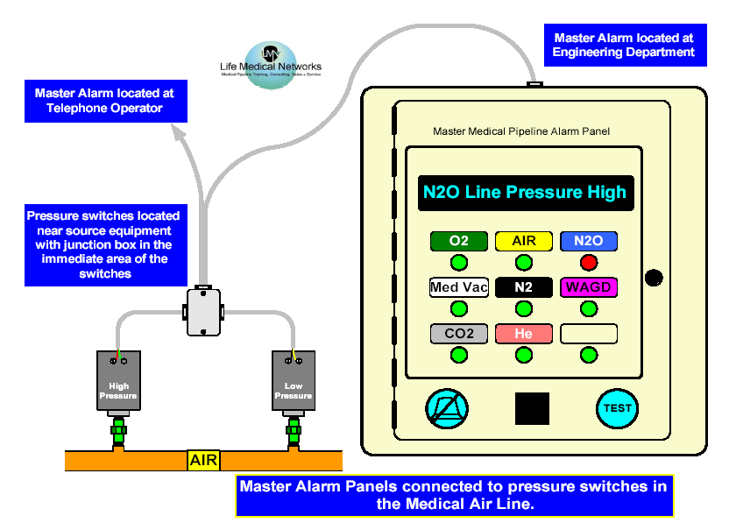
5.1.9.2 Master Alarms
1. Two Separate Locations Required for
Master Alarm Panels
2. Switches or Sensors
3. Separate Visual Alarm Indicators for Each Signal
5. Test Button
4. Cancelable Audible Indicator

Slide 12
Master Alarm Panel

Slide 13
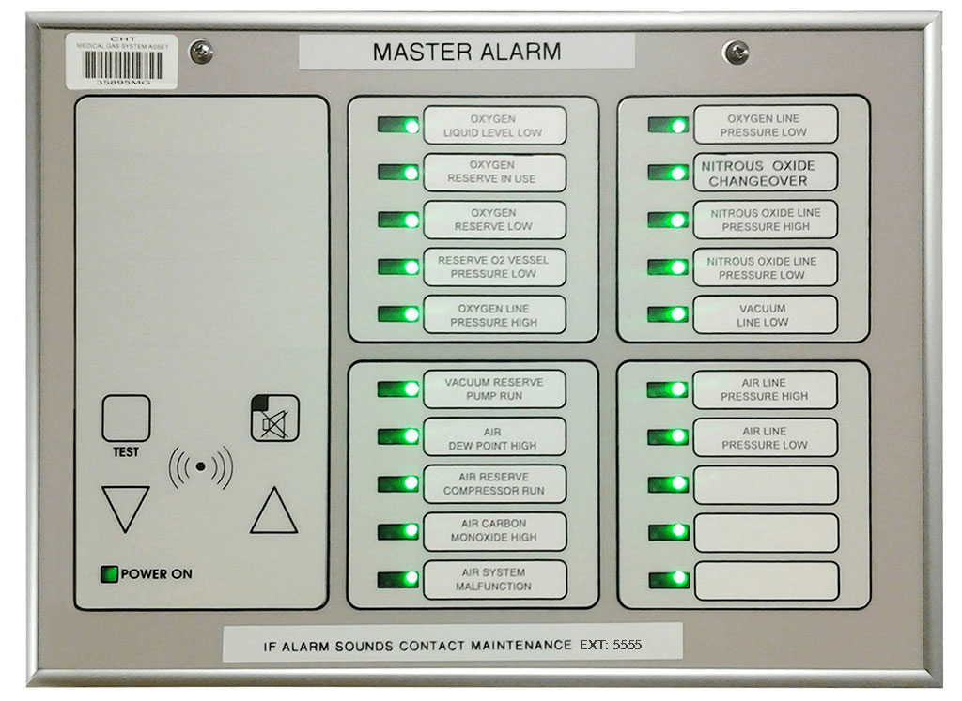

Slide 14
5.1.9.2.5 The alarm indications required in 5.1.9.2.4(7) and
5.1.9.2.4(8) shall originate from sensors installed in the main lines immediately downstream (on the patient or use side) of the source valves. Where it is necessary to install a main line valve in addition to a source valve (see 5.1.4.3), the sensors shall be located downstream (on the patient or use side) of the main valve.
5.1.9.3 Master Alarms by Computer Systems. Computer systems used as substitute master alarms as required by
5.1.9.2.1(2) shall have the mechanical and electrical characteristics described in 5.1.9.3.1 and the programming characteristics described in 5.1.9.3.2.
5.1.9.3.1 Computer systems used to substitute for alarms shall have the following mechanical and electrical characteristics:

Slide 15
(1) The computer system shall be in continuous uninterrupted operation and provided with power supplies as needed to ensure such reliability.
(2) The computer system shall be continuously attended by responsible individuals or shall provide remote signaling of responsible parties (e.g., through pagers, telephone autodialers, or other such means).
(5) Computer systems shall be permitted to communicate directly to the sensors/switches in 5.1.9.2.3 in the same manner as an alarm panel if operation of another alarm panel(s) is not impaired.
(6) Communication from the computer system to the signaling switches or sensors shall be supervised such that failure of communication shall initiate an alarm.

Slide 16
5.1.9.4* Area Alarms. Area alarm panels shall be provided to monitor all medical gas, medical–surgical vacuum, and piped WAGD systems supplying the following:
(1) Anesthetizing locations where moderate sedation, deep sedation, or general anesthesia is administered
(2)* Category 1 space
5.1.9.4.1* Area alarms shall be located at a nurse’s station or other similar location that will provide for surveillance.
5.1.9.4.2 Area alarm panels for medical gas systems shall indicate if the pressure in the lines in the area being monitored increases or decreases by 20 percent from the normal line pressure.
5.1.9.4.3 Area alarm panels for medical–surgical vacuum systems shall indicate if the vacuum in the area drops to or below 300 mm (12 in.) gauge HgV.

Slide 17
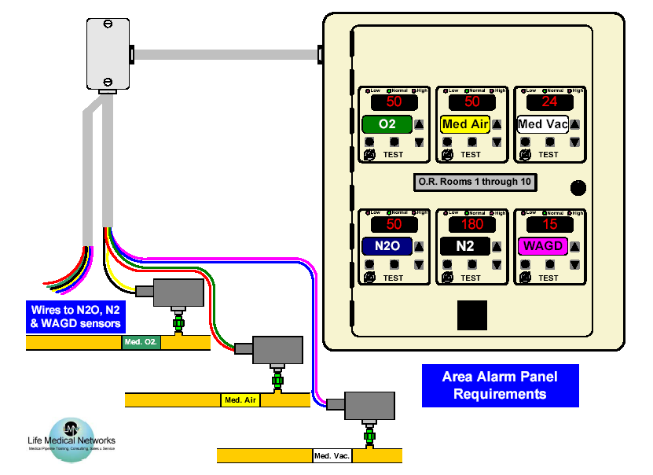
5.1.9.3 Area Alarm
2. Visual Indicators
4. Test Button
1. Pressure or Vacuum Sensors
3. Cancelable Audible Indicator

Slide 18
Area Alarm Panel

Slide 19
5.1.9.4.4 Alarm sensors for area alarms shall be located as follows:
(1)* Category 1 spaces, other than anesthetizing locations addressed in 5.1.9.4.4(2), shall have the alarm sensors installed on the patient or use side of each individual zone valve box assemblies.
(2)* Anesthetizing locations where moderate sedation, deep sedation, or general anesthesia is administered shall have the sensors installed either on the source side of any of the individual room zone valve box assemblies or on the patient or use side of each of the individual zone valve box assemblies.

Slide 20
5.1.9.4.5 One area alarm panel shall be acceptable to monitor multiple rooms located within an immediate vicinity meeting the requirements of 5.1.9.4.4(2).
5.1.9.4.6 Area alarm panels for medical gas systems shall provide visual and audible indication in the event a mismatch occurs between the transducer(s) and its associated circuit board(s).
5.1.9.5* Local Alarms. Local alarms shall be installed to monitor the function of the air compressor system(s), medical–surgical vacuum pump system(s), WAGD systems, instrument air systems, and proportioning systems.
5.1.9.5.1 The signals referenced in 5.1.9.5.4 shall be permitted to be located as follows:
(1) On or in the control panel(s) for the central supply system or supply source being monitored

Slide 21
(2) Within a monitoring device (e.g., dew point monitor or carbon monoxide monitor)
(3) On a separate alarm panel(s)
5.1.9.5.2 The master alarm shall include at least one signal from the source equipment to indicate a problem with the source equipment at this location. This master alarm signal shall activate when any of the required local alarm signals for this source equipment activates.
5.1.9.5.3 If there is more than one central supply system, for a specific gas or vacuum pipeline or more than one central supply system and pipeline for the same gas in the building, then it shall be necessary for each location to have separate local alarms per 5.1.9.5.4 and signals at the master panels per 5.1.9.2.4.

Slide 22
5.1.9.5.4 The following functions shall be monitored at each local alarm site:
(1) Low medical air reserve capacity, to indicate when the medical air source is operating under a demand that could not be managed if one compressor ceased to operate
(2) High carbon monoxide level, to indicate when the carbon monoxide level in the medical air system is 10 ppm or higher
(3) Medical air dew point high, to indicate when the line pressure dew point is greater than +2°C (+35°F)
(4) Low medical vacuum reserve capacity, to indicate when the medical vacuum source is operating under a demand that could not be managed if one pump ceased to operate
(5) Low WAGD reserve capacity, to indicate when the WAGD source is operating under a demand that could not be managed if one producer ceased to operate

Slide 23
(6) Instrument air dew point high, to indicate when the line pressure dew point is greater than −30°C (−22°F)
(7) Low instrument air reserve capacity, if instrument air is provided by a source with more than one compressor, to indicate when the instrument air source is operating under a demand that could not be managed if one compressor ceased to operate
(8) For compressor systems using liquid ring compressors or compressors with water-cooled components, high water in the receiver tank, to indicate when the water level in the receiver tank has reached a level determined to be detrimental to the operation of the system
(9) For compressor systems using liquid ring compressors, high water in the separator
(10) For compressor systems using other than liquid ring compressors, high discharge air temperature

Slide 24
(11) Proportioning systems high/low indicator when the oxygen concentration is outside the 19.5 percent to 23.5 percent oxygen range
(12) Proportion systems reserve system in operation
(13) When oxygen is supplied from an oxygen central supply system using concentrators (see 5.1.3.9), the following signals shall be provided at the system’s local alarm site(s):
(a) For each cylinder header used as a source, an alarm indication that the header is in use
(b) For each cylinder header used as a source, an alarm indication that the cylinder contents are below one average day’s supply

Slide 25
(c) If the source in use changes because of a failure to appropriately supply the system, an alarm indication indicating an unexpected oxygen supply change has occurred
(d) An alarm indication that the pressure in the common line on the source side of the line pressure controls is low
(e) An alarm indication that the oxygen concentration from the supply system is below 91 percent

Slide 26
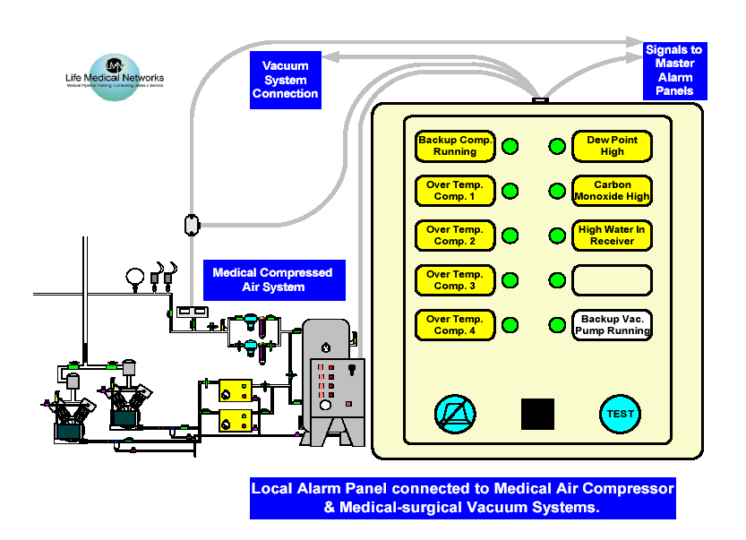
5.1.9.5 Local Alarm:
1. Connected Medical Pipeline Source Equipment
3. Signals From Other Source Equipment
2. Required Medical Air System Signals
5. Test Button
4. Cancelable Audible Indicator

