Slide 1
2021 Code
5.1.5* Station Outlets/Inlets.
5.1.5.1 Each station outlet/inlet for medical gases or vacuums shall be gas-specific, whether the outlet/inlet is threaded or is a noninterchangeable quick coupler.
5.1.5.2 Each station outlet shall consist of a primary and a secondary valve (or assembly).
5.1.5.3 Each station inlet shall consist of a primary valve (or assembly) and shall be permitted to include a secondary valve (or assembly).
5.1.5.5 Each outlet/inlet shall be legibly identified in accordance with 5.1.11.3.
5.1.5.6 Threaded outlets/inlets shall be noninterchangeable connections complying with the mandatory requirements of CGA V-5, Diameter-Index Safety System (Noninterchangeable Low Pressure Connections for Medical Gas Applications).

Slide 2
5.1.5.11 Factory-installed copper inlet tubes on station outlets extending no further than 205 mm (8 in.) from the body of the terminal shall be not less than DN8 (NPS 1∕4) (3∕8 in. O.D.) size, with 8 mm (0.3 in.) minimum inside diameter.
5.1.5.12 Factory-installed copper outlet tubes on station inlets extending no further than 205 mm (8 in.) from the body of the terminal shall be not less than DN10 (NPS 3∕8) (1∕2 in. O.D.) size, with 10 mm (0.4 in.) minimum inside diameter.
5.1.5.15 Station outlets in systems having nonstandard operating pressures shall meet the following additional requirements:
(1) They shall be gas-specific.
(2) They shall be pressure-specific where a single gas is piped at more than one operating pressure [e.g., a station outlet for oxygen at 550 kPa (80 psi) shall not accept an adapter for oxygen at 345 kPa (50 psi)].

Slide 3
4. Factory Installed Tube
3. Gas Specific Design
1. Primary Check Valve
2. Secondary Check Valve

Slide 4
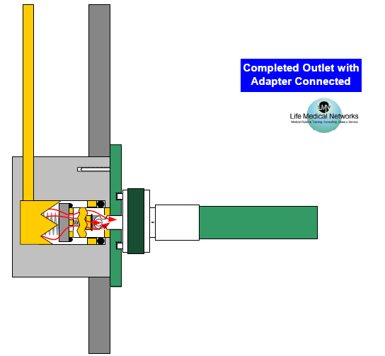

Slide 6
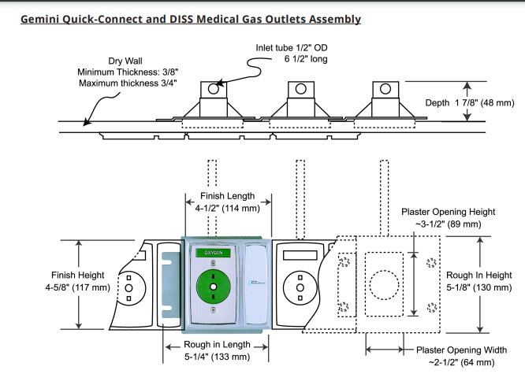
Wall Outlet Dimensions

Slide 7
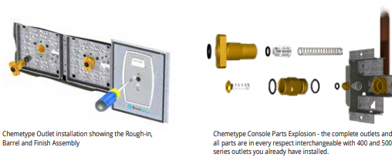
Wall Outlet Internal Parts

Slide 8
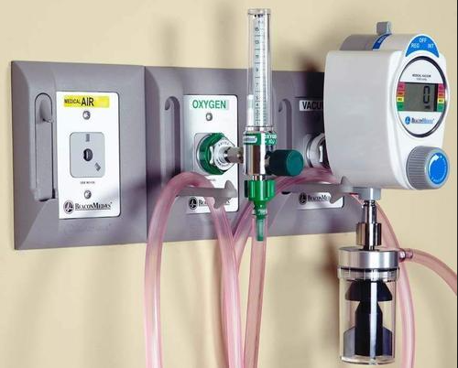
Example of Finished Outlets

Slide 9
(3) If operated at a pressure in excess of 550 kPa (80 psi), they shall be either D.I.S.S. connectors or comply with 5.1.5.15(4).
(4) If operated at a gauge pressure between 1380 kPa and 2070 kPa (200 psi and 300 psi), the station outlet shall be designed so as to prevent the removal of the adapter until the pressure has been relieved to prevent the adapter injuring the user or others when removed from the outlet.
5.1.5.16 WAGD networks shall provide a WAGD inlet in all locations where nitrous oxide or halogenated anesthetic gas is intended to be administered.

Slide 10
5.1.5.17 Where installed in a down-facing position, such as in a ceiling or ceiling column, station outlets/inlets shall be D.I.S.S. connectors.
5.1.6* Manufactured Assemblies.
5.1.6.2 The leakage from a completed manufactured assembly shall not exceed 0.006 cm³/sec (0.00037 in.³/sec) when tested at 20 percent above operating pressure for pressure pipelines and shall not exceed 0.002 cm³/sec (0.00012 in.³/sec) for vacuum and WAGD systems when started at 635 mm (25 in.) HgV.
5.1.6.3 The manufacturer of the assembly shall provide documentation certifying the performance and successful completion of the tests required in 5.1.6.1.
5.1.6.4 Manufactured assemblies employing flexible hose shall use hose and flexible connectors with a minimum burst gauge pressure of 6895 kPa (1000 psi).

Slide 11
5.1.6.5 The manufacturer of the assembly shall provide documentation certifying that the flexible hose assembly has a minimum burst gauge pressure of 6895 kPa (1000 psi).
5.1.6.6 Components of manufactured assemblies shall have a flame spread index of not greater than 200 when tested in accordance with ASTM E84, Standard Test Method for Surface Burning Characteristics of Building Materials, or ANSI/UL 723, Standard for Test for Surface Burning Characteristics of Building Materials, or shall comply with the requirements for heat release in accordance with NFPA 286 as described in Section 10.2 of NFPA 101.
5.1.6.7 Manufactured assemblies employing flexible hose or tubing shall be attached to the pipelines using station outlets/inlets

Slide 12
5.1.6.8 Manufactured assemblies employing hose or flexible connectors, where the station outlet/inlet attached to the piping is not fully and immediately accessible (i.e., cannot be manipulated without the removal of panels, doors, and so forth), shall have station outlets/inlets with the following additional characteristics:
(1) They shall be gas-specific connections with positive locking mechanisms that ensure the connector is firmly seated and cannot detach without intentional actuation of the release (e.g., D.I.S.S. connectors).
(3) In vacuum and WAGD, they shall be permitted to omit both primary and secondary valves (or assemblies) for minimum restriction to flow.

Slide 13
5.1.6.9 Hose or flexible connectors employed in manufactured assemblies shall be labeled by stenciling or adhesive markers that identify the patient medical gas, the support gas, or the vacuum system and include the following:
(1) Name of the gas or vacuum system or the chemical symbol per Table 5.1.11
(2) Gas or vacuum system color code per Table 5.1.11
(3) Where positive-pressure piping systems operate at pressures other than the standard gauge pressure in Table 5.1.11, the operating pressure in addition to the name of the gas
(4) Date of installation
5.1.6.10 Station outlets/inlets installed in manufactured assemblies connected to the pipeline by brazing shall comply with 5.1.5.

Slide 14
5.1.7.3 MGR assemblies shall be made of materials with a melting point of at least 538°C (1000°F).
5.1.7.5 Station outlets or inlets shall not be placed on the ends of MGR assemblies
5.1.7.7 Openings in the MGR not occupied by station outlets/inlets (e.g., for future use) shall be capped or plugged so that a special tool is required for removal (i.e., cannot be removed by a wrench, pliers, a screwdriver, or other common tool).
5.1.7.8 MGR assemblies shall connect to the pipeline through fittings that are brazed to the pipeline.
5.1.8.1.3* The scale range of positive pressure analog indicators shall be such that the normal operating pressure is within the middle third of the total range [e.g., an indicator of 0 to 2070 kPa (0 to 300 psi) would have a lower third of 0 to 690 kPa (0 to 100 psig), a middle third of 690 kPa to 1380 kPa (100 psig to 200 psig), and a top third of 1380 kPa to 2070 kPa (200 psig to 300 psig)].

Slide 15
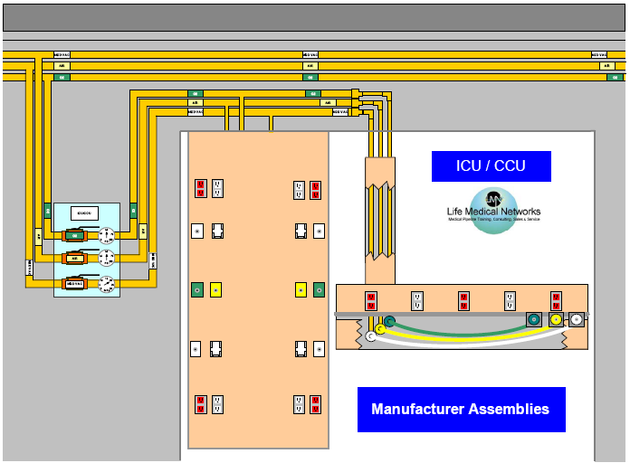
1. Manufactured Assemblies, Connected by Brazing
2. Manufactured Assemblies, Connected by Flexible Hoses
4. User Connection
3. Flexible Hoses

Slide 16
3. Flexible Hoses
2. Manufactured Equipment, Flexible Hose Connection
4. User Connection
1. Ceiling Hose Drops

Slide 17
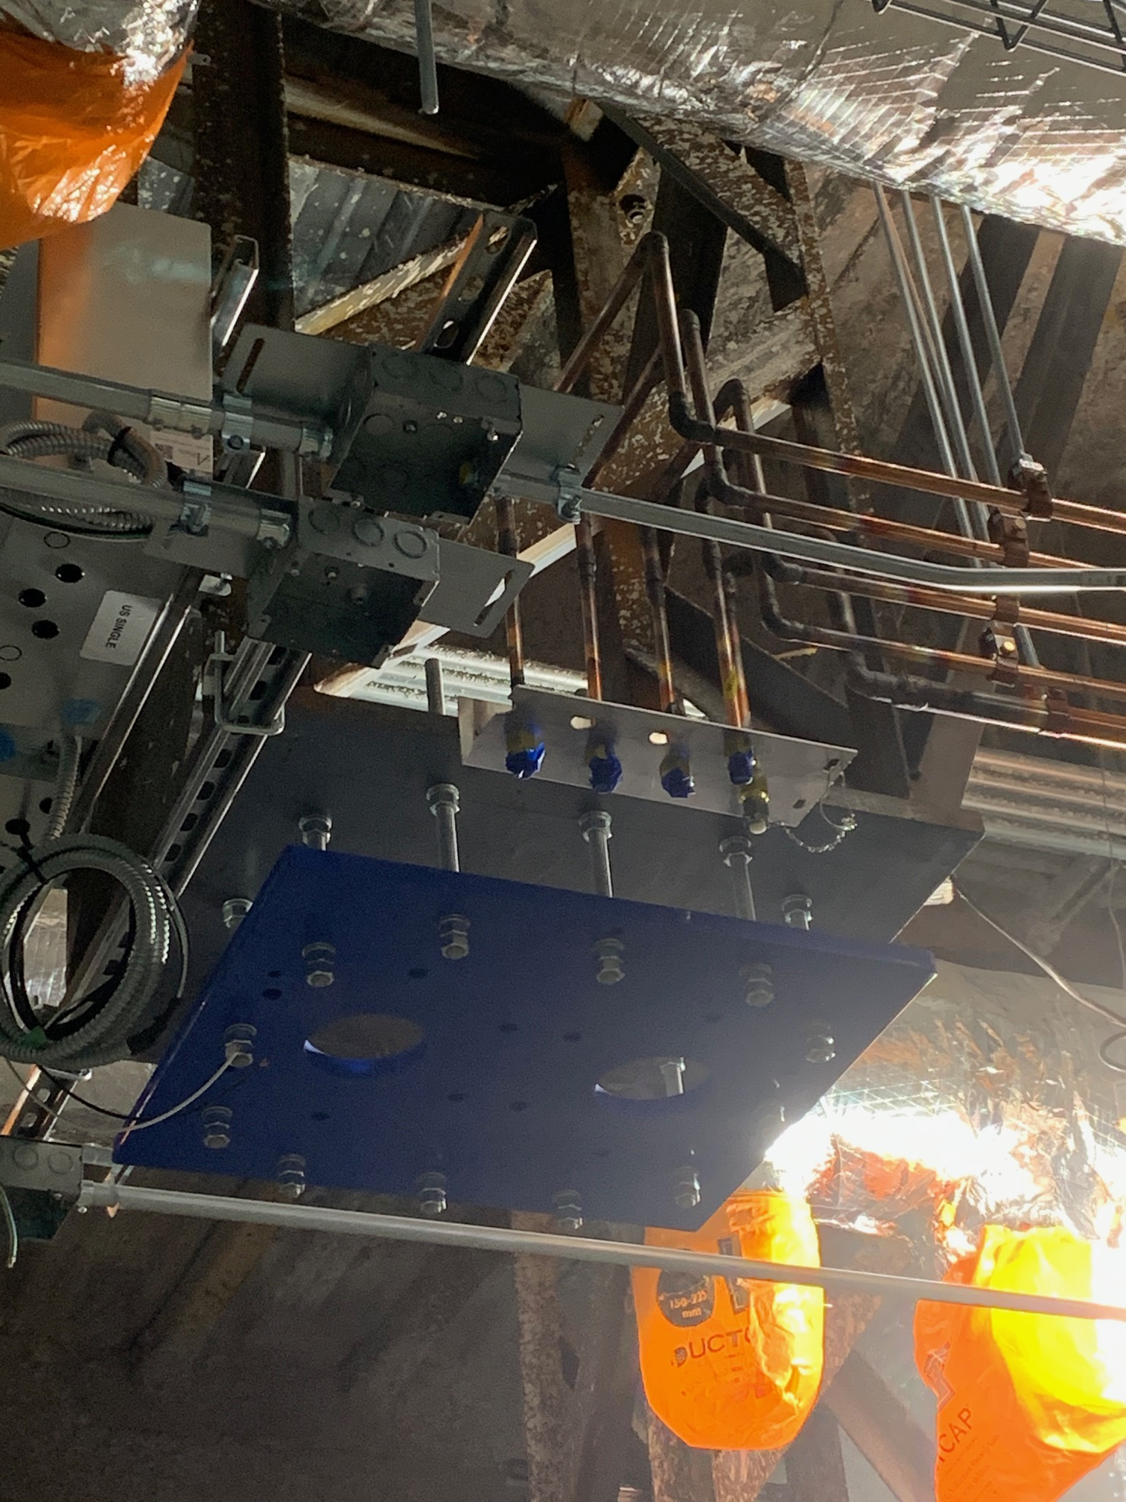
Boom Piping to DISS Connectors

Slide 18
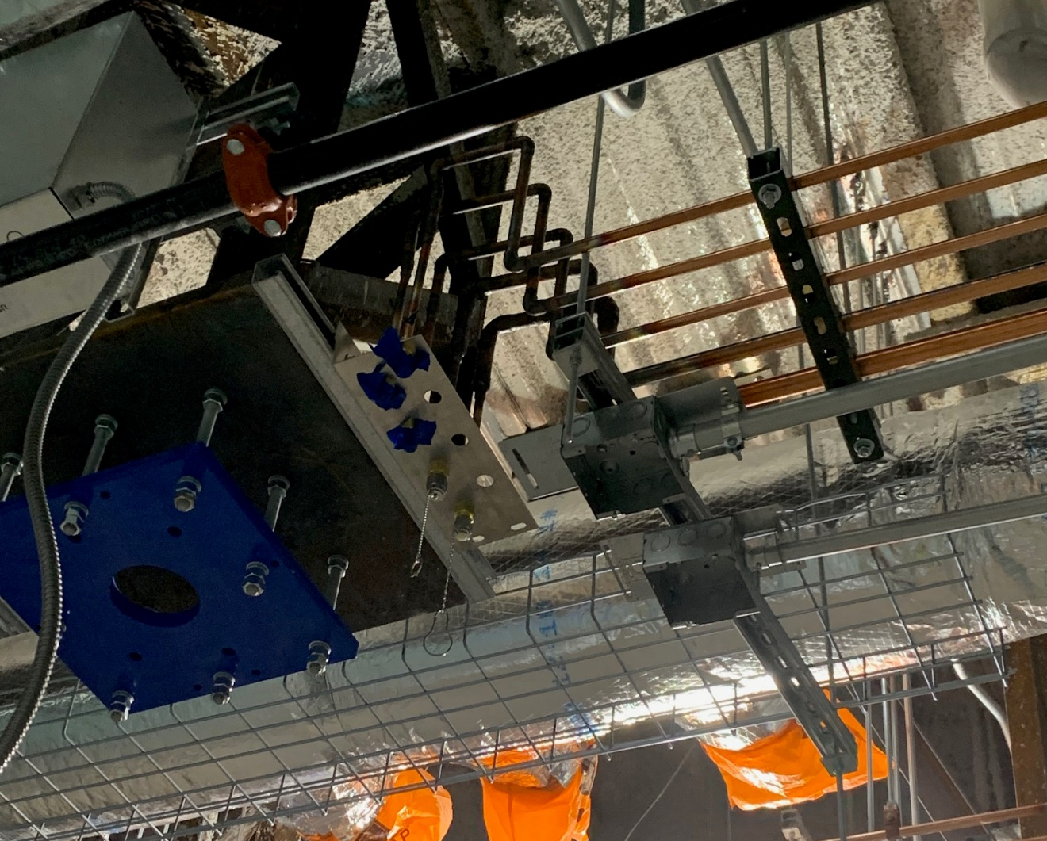
Boom Piping to DISS Connectors

Slide 19
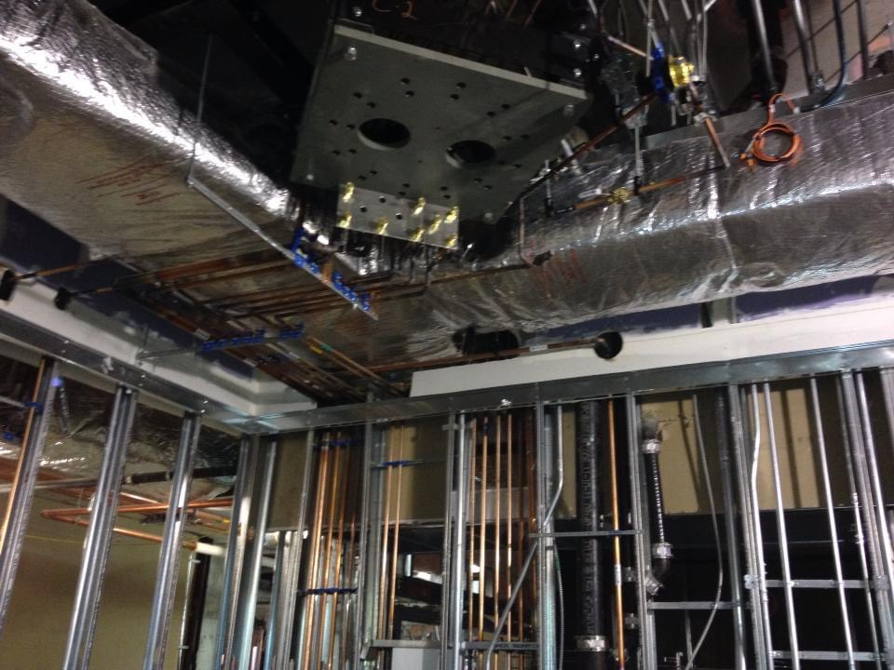
Boom Piping To DISS Connectors. Nitrogen Brake.

Slide 20
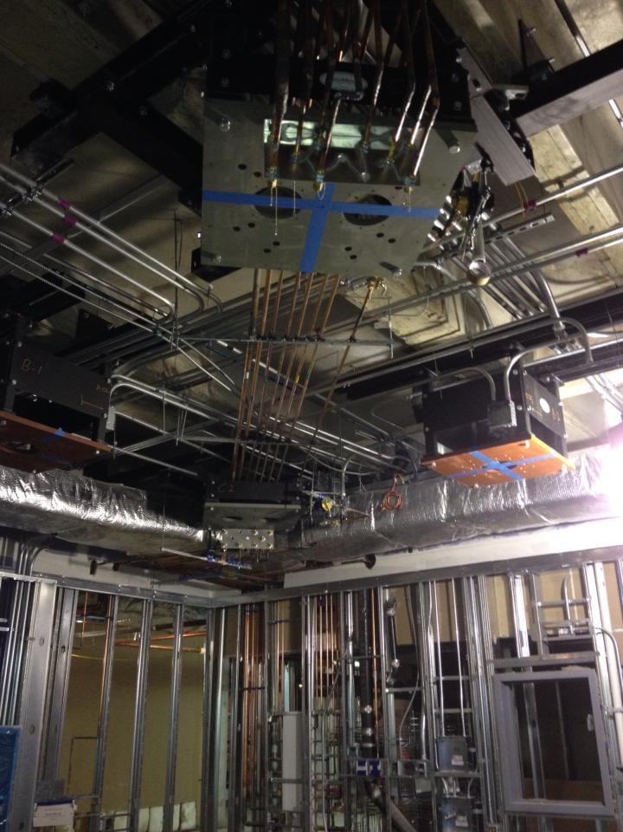
Boom Piping To DISS Connectors. Nitrogen Brake.

Slide 21
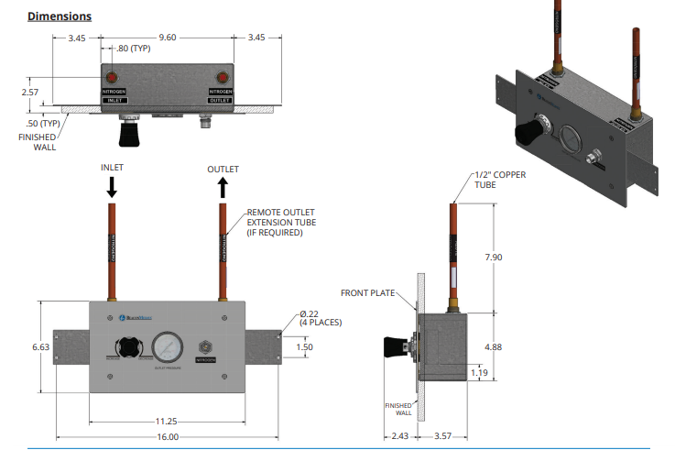
Nitrogen High Pressure Regulator

Slide 22
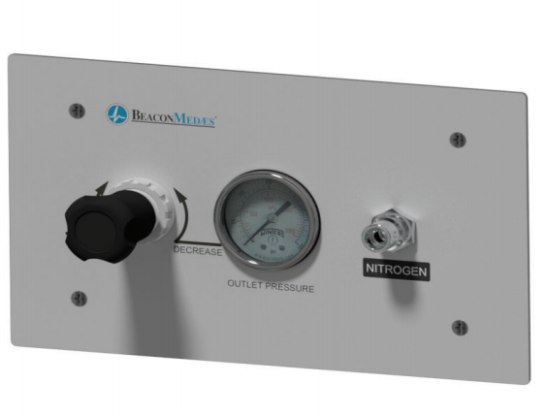
High Pressure Regulator

Slide 23
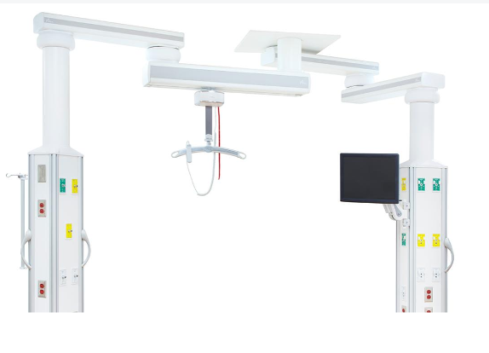
Pendant Boom Finished

Slide 24
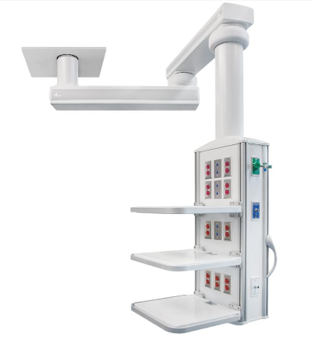
Operating Room Boom

Slide 25
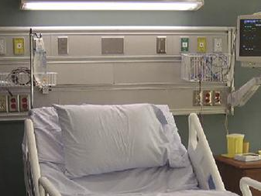
Recessed Surface Mounted Medical Gas Rails

Slide 26

Cabinet Style Headwall

Slide 27
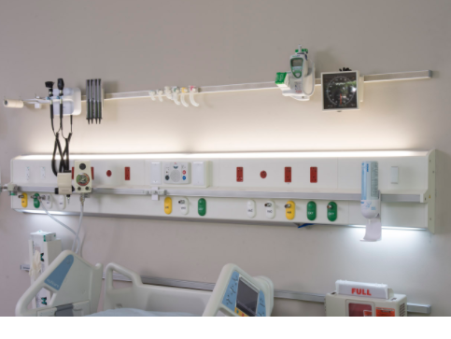
Surface Mounted Medical Gas Rail

Slide 28
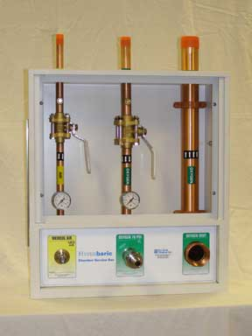
Hyperbaric Valve Box

Slide 29
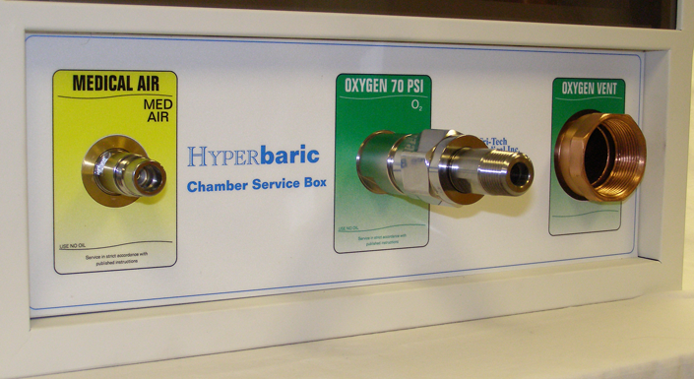

Slide 30
5.1.8.1.4 The accuracy of digital indicators shall be ±5 percent of the operating pressure at which they are used.
5.1.8.1.5 The scale range of vacuum indicators shall be 0 to 760 mm
(0 to 30 in.) gauge HgV. Indicators with a normal range display shall indicate normal only above 300 mm (12 in.) gauge HgV.
5.1.8.1.6 Indicators adjacent to master alarm actuators and area alarms shall be labeled to identify the name of, or chemical symbol for, the particular piping system that they monitor.
5.1.8.2 Locations.
5.1.8.2.1 Pressure/vacuum indicators shall be readable from a standing position.
5.1.8.2.2 Pressure/vacuum indicators shall be provided at the following locations, as a minimum:

Slide 31
(1) Adjacent to the alarm-initiating device for source main line pressure and vacuum alarms in the master alarm system
(2) At or in area alarm panels to indicate the pressure/vacuum at the alarm-activating device for each system that is monitored by the panel
(3) On the station outlet/inlet side of zone valves
5.1.8.2.3 All pressure-sensing devices and main line pressure gauges downstream of the source valves shall be provided with a gas-specific demand check fitting to facilitate service testing or replacement.
5.1.8.2.3.1 Gas-specific demand check fittings shall not be required on zone valve pressure indicators.
5.1.8.2.4 Demand check fittings shall be provided for all monitors.

Slide 32
11.2.8 Cylinder valve outlet connections for oxygen shall be Connection No. 540 or Connection No. 870 as described in the mandatory requirements of CGA V-1, Standard for Compressed Gas Cylinder Valve Outlet and Inlet Connections (ANSI B57.1).
11.2.9 Cylinder valve outlet connections for nitrous oxide shall be Connection No. 326 or Connection No. 910 as described in the mandatory requirements of CGA V-1, Standard for Compressed Gas Cylinder Valve Outlet and Inlet Connections (ANSI B57.1).
11.3.5 * Design and Construction.
11.3.5.1 Storage for nonflammable gases equal to or greater than 85 m³ (3000 ft³) at STP shall comply with 11.3.5.2 unless such installations are approved existing installations, which shall be permitted to be continued in service.
11.3.5.2 Locations for the storage of nonflammable gases shall meet the following requirements:
(1) They shall be constructed with access to move cylinders and containers in and out of the location on hand trucks complying with 11.4.3.1.1.
(2) They shall be provided with lockable doors or gates or otherwise able to be secured.
(3) If outdoors, they shall be provided with an enclosure constructed of noncombustible materials.
(4) If indoors, they shall have interior finishes of noncombustible or limited-combustible materials.

Slide 33
(5)* If indoors, the room shall be separated from the rest of the building by walls and floors having a 1-hour fire resistance rating with doors and other opening protectives having a ¾-hour fire protection rating.
(6)* They shall comply with NFPA 70 for unclassified (non­hazardous) locations.
(7)* Fuel-fired equipment shall not be located in the room.
(8) If they require heat, the maximum allowable temperature of the in-room heating element shall be 130°C (266°F).
(9) They shall be provided with racks, chains, or other fastenings to secure all cylinders from falling, whether full or empty.
(10) They shall be supplied with electrical power compliant with the requirements for essential electrical systems as described in Chapter 6.
(11) They shall have racks, shelves, and supports, where provided, constructed of noncombustible materials or limited-combustible materials.
(12)* They shall protect electrical devices from physical damage.
(13)* They shall allow access by delivery vehicles and management of cylinders.
(14) If indoors, ventilation for medical gas storage rooms shall comply with 9.3.6.

Slide 34
11.3.6.3 Oxidizing gases such as oxygen and nitrous oxide shall be separated from combustibles or flammable materials by one of the following:
(1) Minimum distance of 6.1 m (20 ft)
(2) Minimum distance of 1.5 m (5 ft) if the entire storage location is protected by an automatic sprinkler system designed in accordance with NFPA 13
(3) A gas cabinet constructed per NFPA 30 or NFPA 55, if the entire storage location is protected by an automatic sprinkler system designed in accordance with NFPA 13
11.3.6.6 Smoking, open flames, electric heating elements, and other sources of ignition shall be prohibited within storage locations and within 6.1 m (20 ft) of outside storage locations.

Slide 35
11.3.6.8 Ventilation for indoor medical gas storage rooms shall comply with 9.3.6.
11.3.8 * Storage for nonflammable gases less than 85 m³ (3000 ft³) at STP shall be permitted to be stored in a gas cabinet constructed in accordance with NFPA 55, provided that the following also applies:
(1) Storage is limited to cylinders.
(2) There are no flammables or combustibles in the cabinet.
(3) The temperature limitations of 5.1.3.2.11 are met.
(4) The cylinders are secured.
(5) When storing nitrous oxide, the cabinets are lockable.
11.3.11 Cylinders shall not be chained to portable or movable apparatus such as beds and oxygen tents.

Slide 36
11.7.4 Maximum Quantity.
11.7.4.1 The maximum total quantity of liquid oxygen permitted in storage and in use in a patient bed location or patient care vicinity shall be 120 L (31.6 gal), provided that the patient bed location or patient care vicinity, or both, are separated from the remainder of the facility by fire barriers and horizontal assemblies having a minimum fire resistance rating of 1 hour in accordance with the adopted building code.
11.7.4.2 One liquid oxygen portable container [limited to 1.5 L (0.396 gal) capacity] per patient is permitted to be stored or used in a patient bed location or patient care vicinity without having to meet the fire separation requirements of 11.7.4.1.

